Slide 1
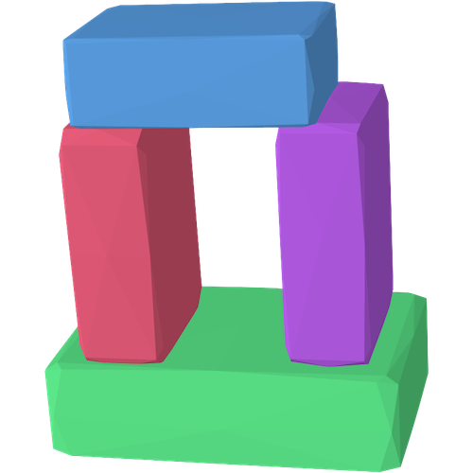
Differentiable Blocks World: Qualitative 3D Decomposition by Rendering Primitives
Paper presentation – July 2023
Tom Monnier¹ Jake Austin² Angjoo Kanazawa²
Alexei A. Efros² Mathieu Aubry¹
1 2
Notes:
Hi everyone thanks a lot for having me in this research group. I am Tom and I will present my PhD work entitled “blablabla”.
In this presentation, I will talk about unsupervised learning, neural networks and various vision tasks like image clustering or 3D reconstruction.

Slide 2
Motivation
3D reconstruction advances
Better renderings
Better geometry
Neural Radiance Fields, ECCV 2020
Limitations
No understanding of the 3D scene
Scene representation is not compact nor interpretable
Difficult integration into simulation pipelines
Notes:
Recent advances in multi-view 3D modeling typically focus on better renderings and better geometry, in particular empowered by the Neural Radiance Fields work published in 2020. However, despite its astonishing performances NeRF has some clear limitations
And these limitations mainly come from the fact that the output of a Nerf is nothing but a soup of colorful particles. Because of that, there is no real understanding of the underlying 3D scene, there is no notion of things on top of other things. Second, the scene representation is not compact and cannot really be interpreted. Finally, this scene representation makes it difficult to integrate into simulation pipelines

Slide 3
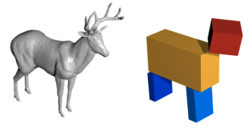
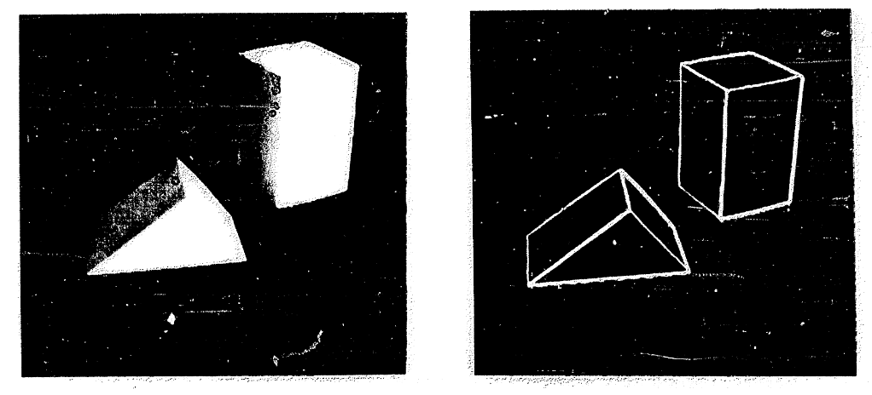
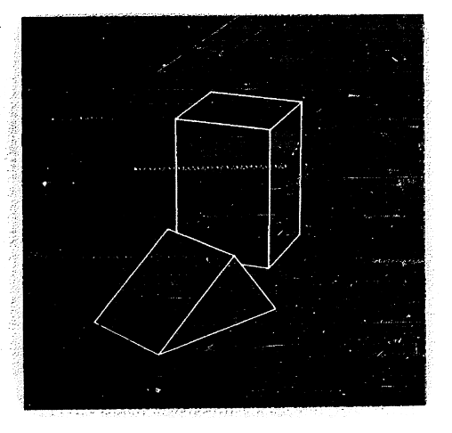
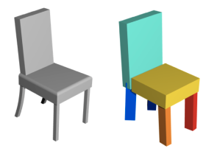
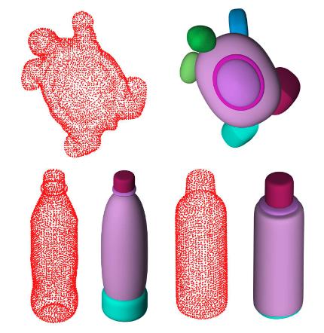
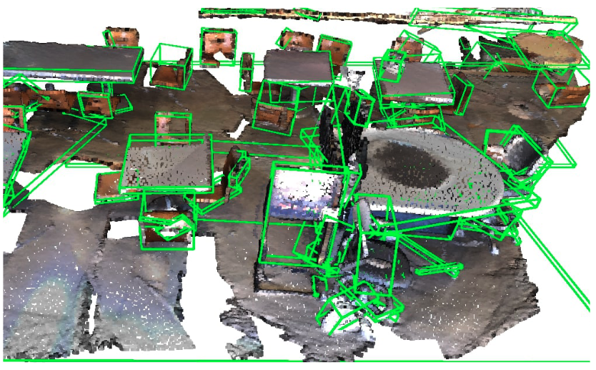
Primitive-based representations – A long history
Blocks World,
Larry Roberts PhD thesis 1963
Input
2D lines
Rotated view
Shape abstraction, CVPR 2018
EMS, CVPR 2022
MBF, ECCV 2022
Notes:
On the other hand, representations to model 3D parts in a scene has a long history and they mainly relies on geometric primitives. Larry Roberts introduced in one of the first computer vision thesis back in 1963, the blocks world idea, where blocks are inferred from toy images by detecting and matching lines. Because this problem is extremely challenging for real images, recent works typically focus on the simpler problem of decomposing 3D data into 3D primitives. As a result, they are typically not robust to real 3D scans that are extremeley noisy and incomplete.

Slide 4
Differentiable Blocks World
Notes:
In this work, we take direct inspiration from Blocks World and recent multi-view modeling, and propose to compute 3D decomposition directly from multi-view images. Specifically, given a set of calibrated images, we optimize primitive meshes in an end-to-end fashion by maximizing the photometric consistency across the different views. That is, we solve the 3D decomposition and multi-view stereo problems simultaneously.
Here are videos outlining the quality of both our 3D decomposition and our textured reconstructions.

Slide 5
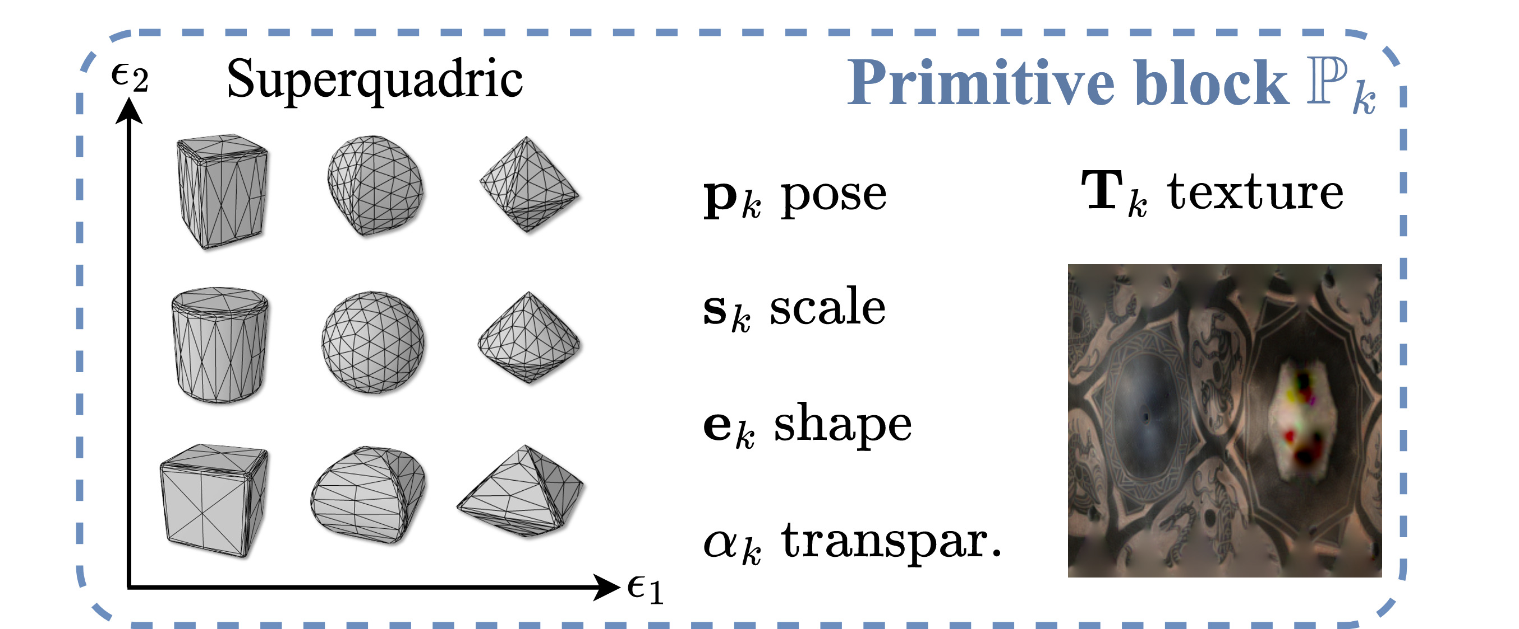
DBW - Pipeline overview
Optimization evolution
View synthesis
Notes:
Let me briefly describe a high-level overview of our pipeline. We propose to represent a 3D world scene as the union of primitive meshes composed of an icosphere modeling a background dome at infinity, a plane modeling the ground and K primitive blocks in the form of superquadric meshes, where K is fixed. The shape textures are represented with texture images UV mapped onto the shape surface. But one key component of our approach is to handle variable number of primitives by modeling meshes that are transparent. By adjusting their transparency, we can softly make them appear or disappear during the optimization. Finally, scene parameters are initialized randomly and optimized end-to-end by maximizing photo-consistency, in a fashion similar to NeRF. Here we show the evolution of the optimization process starting from scratch.
[play video]
The resulting primitive-based reconstruction allows us to perform qualitative novel view synthesis.

Slide 6
DBW – Optimization process

Slide 7
DBW – Quantitative comparison to SOTA

Slide 8
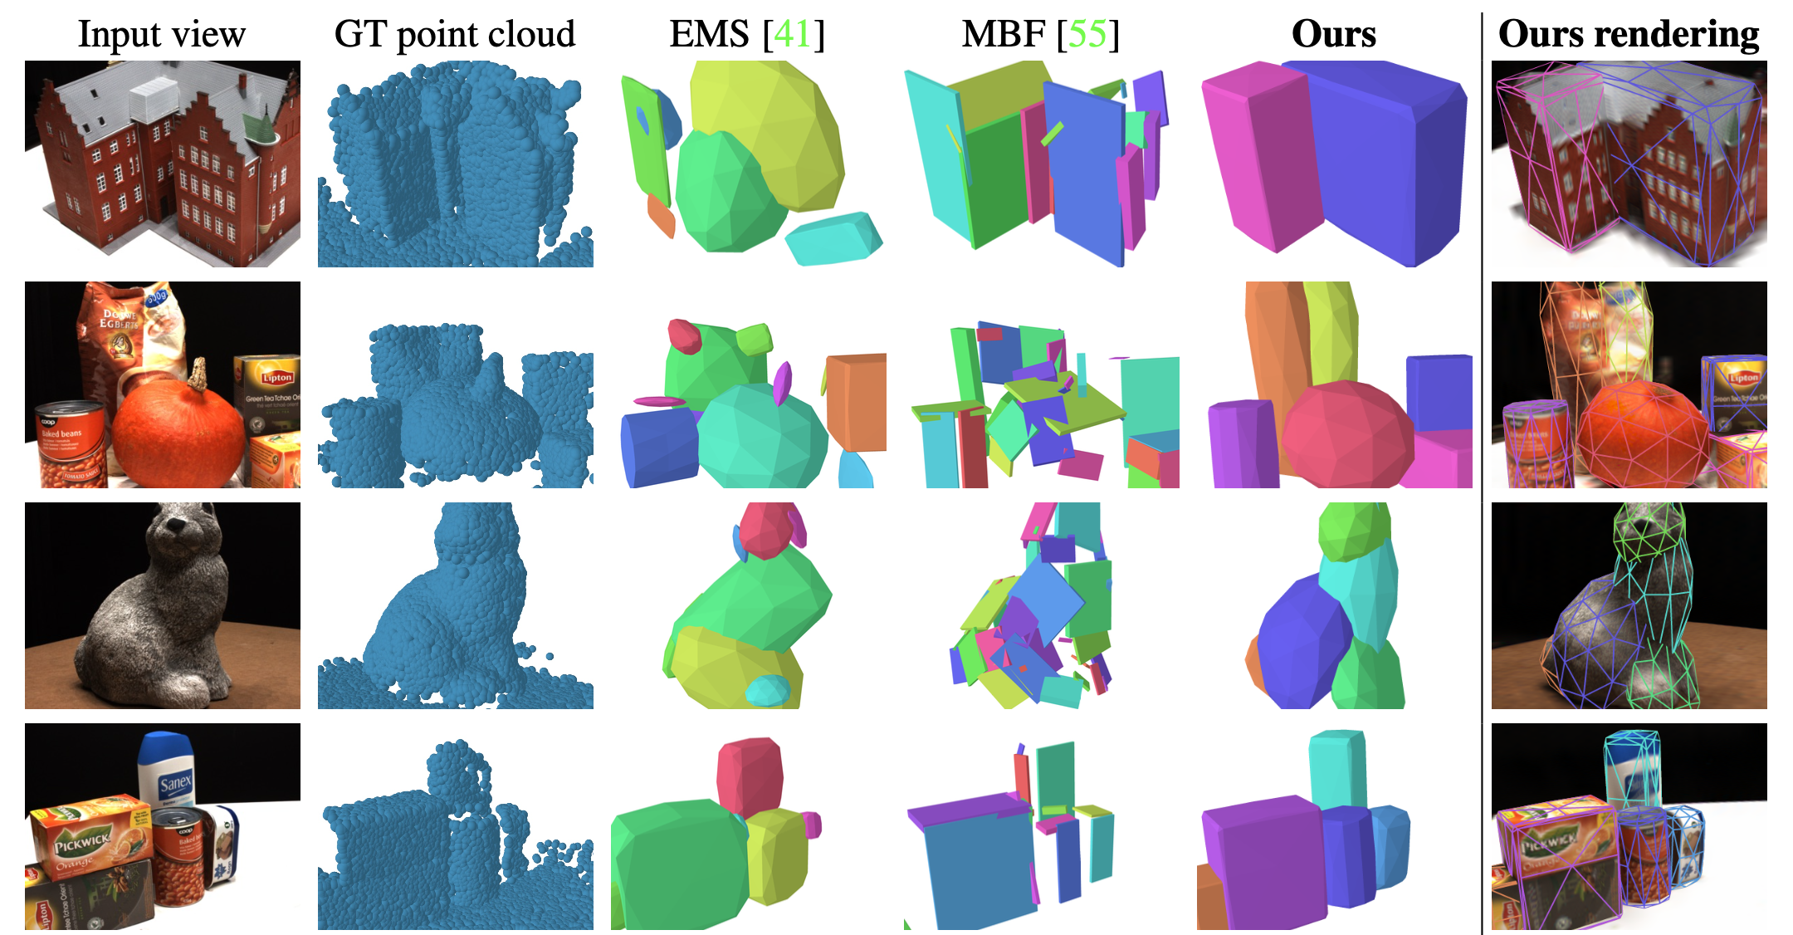
Qualitative comparisons
Notes:
We compared our approach on DTU to sota 3D decomposition methods, which in contrast to ours, find primitives in the ground-truth 3D pointcloud shown in the 2nd column. Because our method does not rely on the GT which is noisy and extremely incomplete, our method outputs decompositions that are much more satisfying than prior works.

Slide 9
Qualitative results for real captures
Notes:
We also demonstrate decomposition results on real-life captures from BlendedMVS and manually captured scenes from Nerfstudio.

Slide 10
Applications – Physics-based simulations
Notes:
Finally, the ultimate benefit of our primitive-based representation is that it can directly be incorporated into computer graphics frameworks to perform physical simulations.
[play video]

