Slide 1
docExtractor: An off-the-shelf
historical document element extraction
International Conference on Frontiers of Handwriting Recognition, 2020
Tom Monnier and Mathieu Aubry
LIGM, Ecole des Ponts, Univ Gustave Eiffel, CNRS
Open source
Open source
Demo
Notes:
Hi, I am Tom Monnier and I am going to present our work “docExtractor: an off-the-shelf historical document element extraction”.

Slide 2
Motivation
Need easy-to-use and efficient
automatic tools for document analysis!
Massive digitalization
Notes:
After years of massive digitalization, there are now thousands of historical document scans waiting to be analysed. In the context of a rising interest in digital humanities the need for easy to use and efficient automatic tools has dramatically increased.

Slide 3
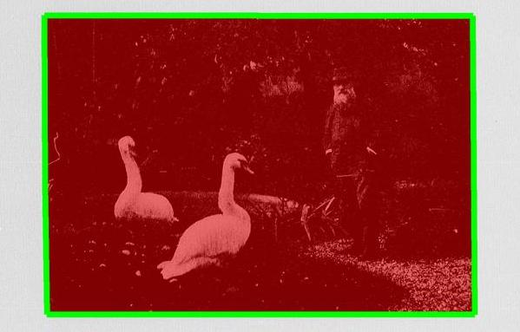
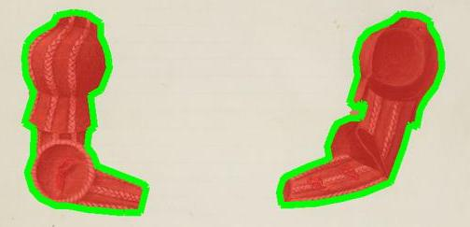
Motivation
Text detection
for dataset A
A
Text detection
for dataset B
B
Photo extraction
for dataset C
C
Drawing extraction
for dataset D
D
Notes:
Document analysis is usually broken down into multiple subproblems depending on the task and the document specificity including handwritten/printed distinction, langage, or degree of degradation.

Slide 4
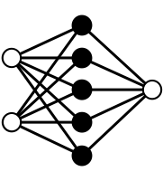
Motivation
Manual data annotation
A
B
C
D
Text detection
for dataset A
A
Text detection
for dataset B
B
Photo extraction
for dataset C
C
Drawing extraction
for dataset D
D
Notes:
Recent advances in deep learning enabled the development of powerful generic solutions that can tackle multiple analysis tasks with a same core method. However, it still require training phase specific to each task with appropriate set of manual annotations.

Slide 5
Motivation
Manual data annotation
A
B
C
D
Text detection
for dataset A
A
Text detection
for dataset B
B
Photo extraction
for dataset C
C
Drawing extraction
for dataset D
Pb: Systems are problem-specific and require dedicated annotations
D
Notes:
Therefore document analysis systems can still be considered problem-specific, limiting their use in practice and their generalization capacity.

Slide 6
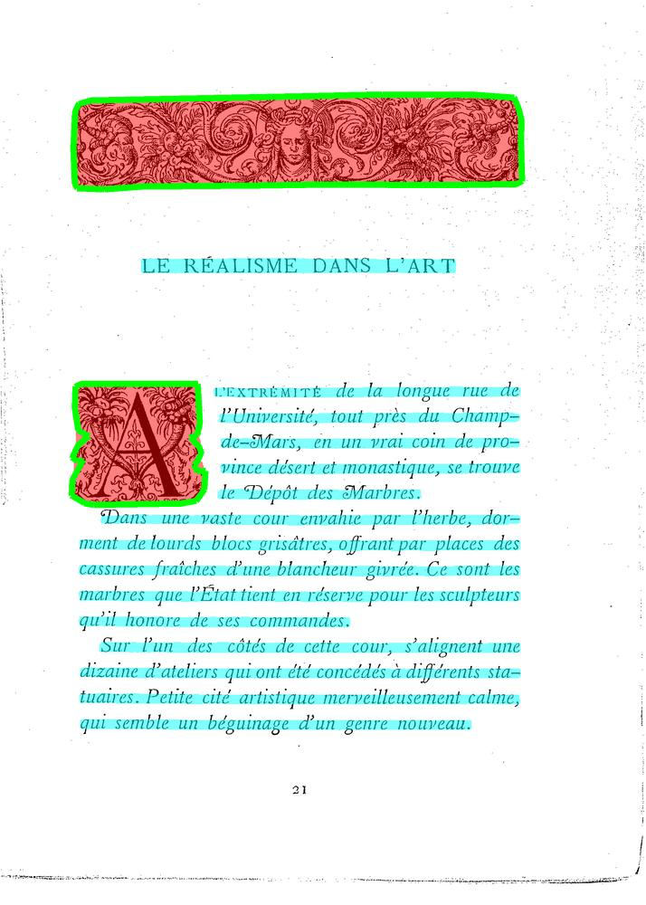
Our idea
Synthetic data with annotations
Generic
Text detection
Generic
Illustration extraction
Single system that only uses synthetic data
for robust real data applications
Notes:
Our goal is to develop a single system for generic element extraction that can directly be applied to unseen datasets with strong performances. Our main idea is to leverage the genericity of synthetic data for robust real data applications. To demonstrate the efficiency of such system, we developed a

Slide 7
Notes:
A web application where one can browse and select a document … click on a particular page … and view all the generated annotations.

Slide 8
Contributions
A synthetic document generation pipeline with fine GT
Notes:
We would like to highlight 3 main contributions in this work. First, we developed a fast and scalable synthetic document generation pipeline.

Slide 9
Contributions
A synthetic document generation pipeline with fine GT
A new system with impressive performances on unseen data
Notes:
Then we introduced a new ready-to-use system for element extraction, that leads to impressive performances on real unseen datasets

Slide 10
Contributions
A synthetic document generation pipeline with fine GT
A new system with impressive performances on unseen data
A new public dataset for illustration segmentation (IlluHisDoc)
Notes:
Finally, we released a new public dataset dubbed IlluHisDoc, for the fine evaluation of illustration segmentation.

Slide 11
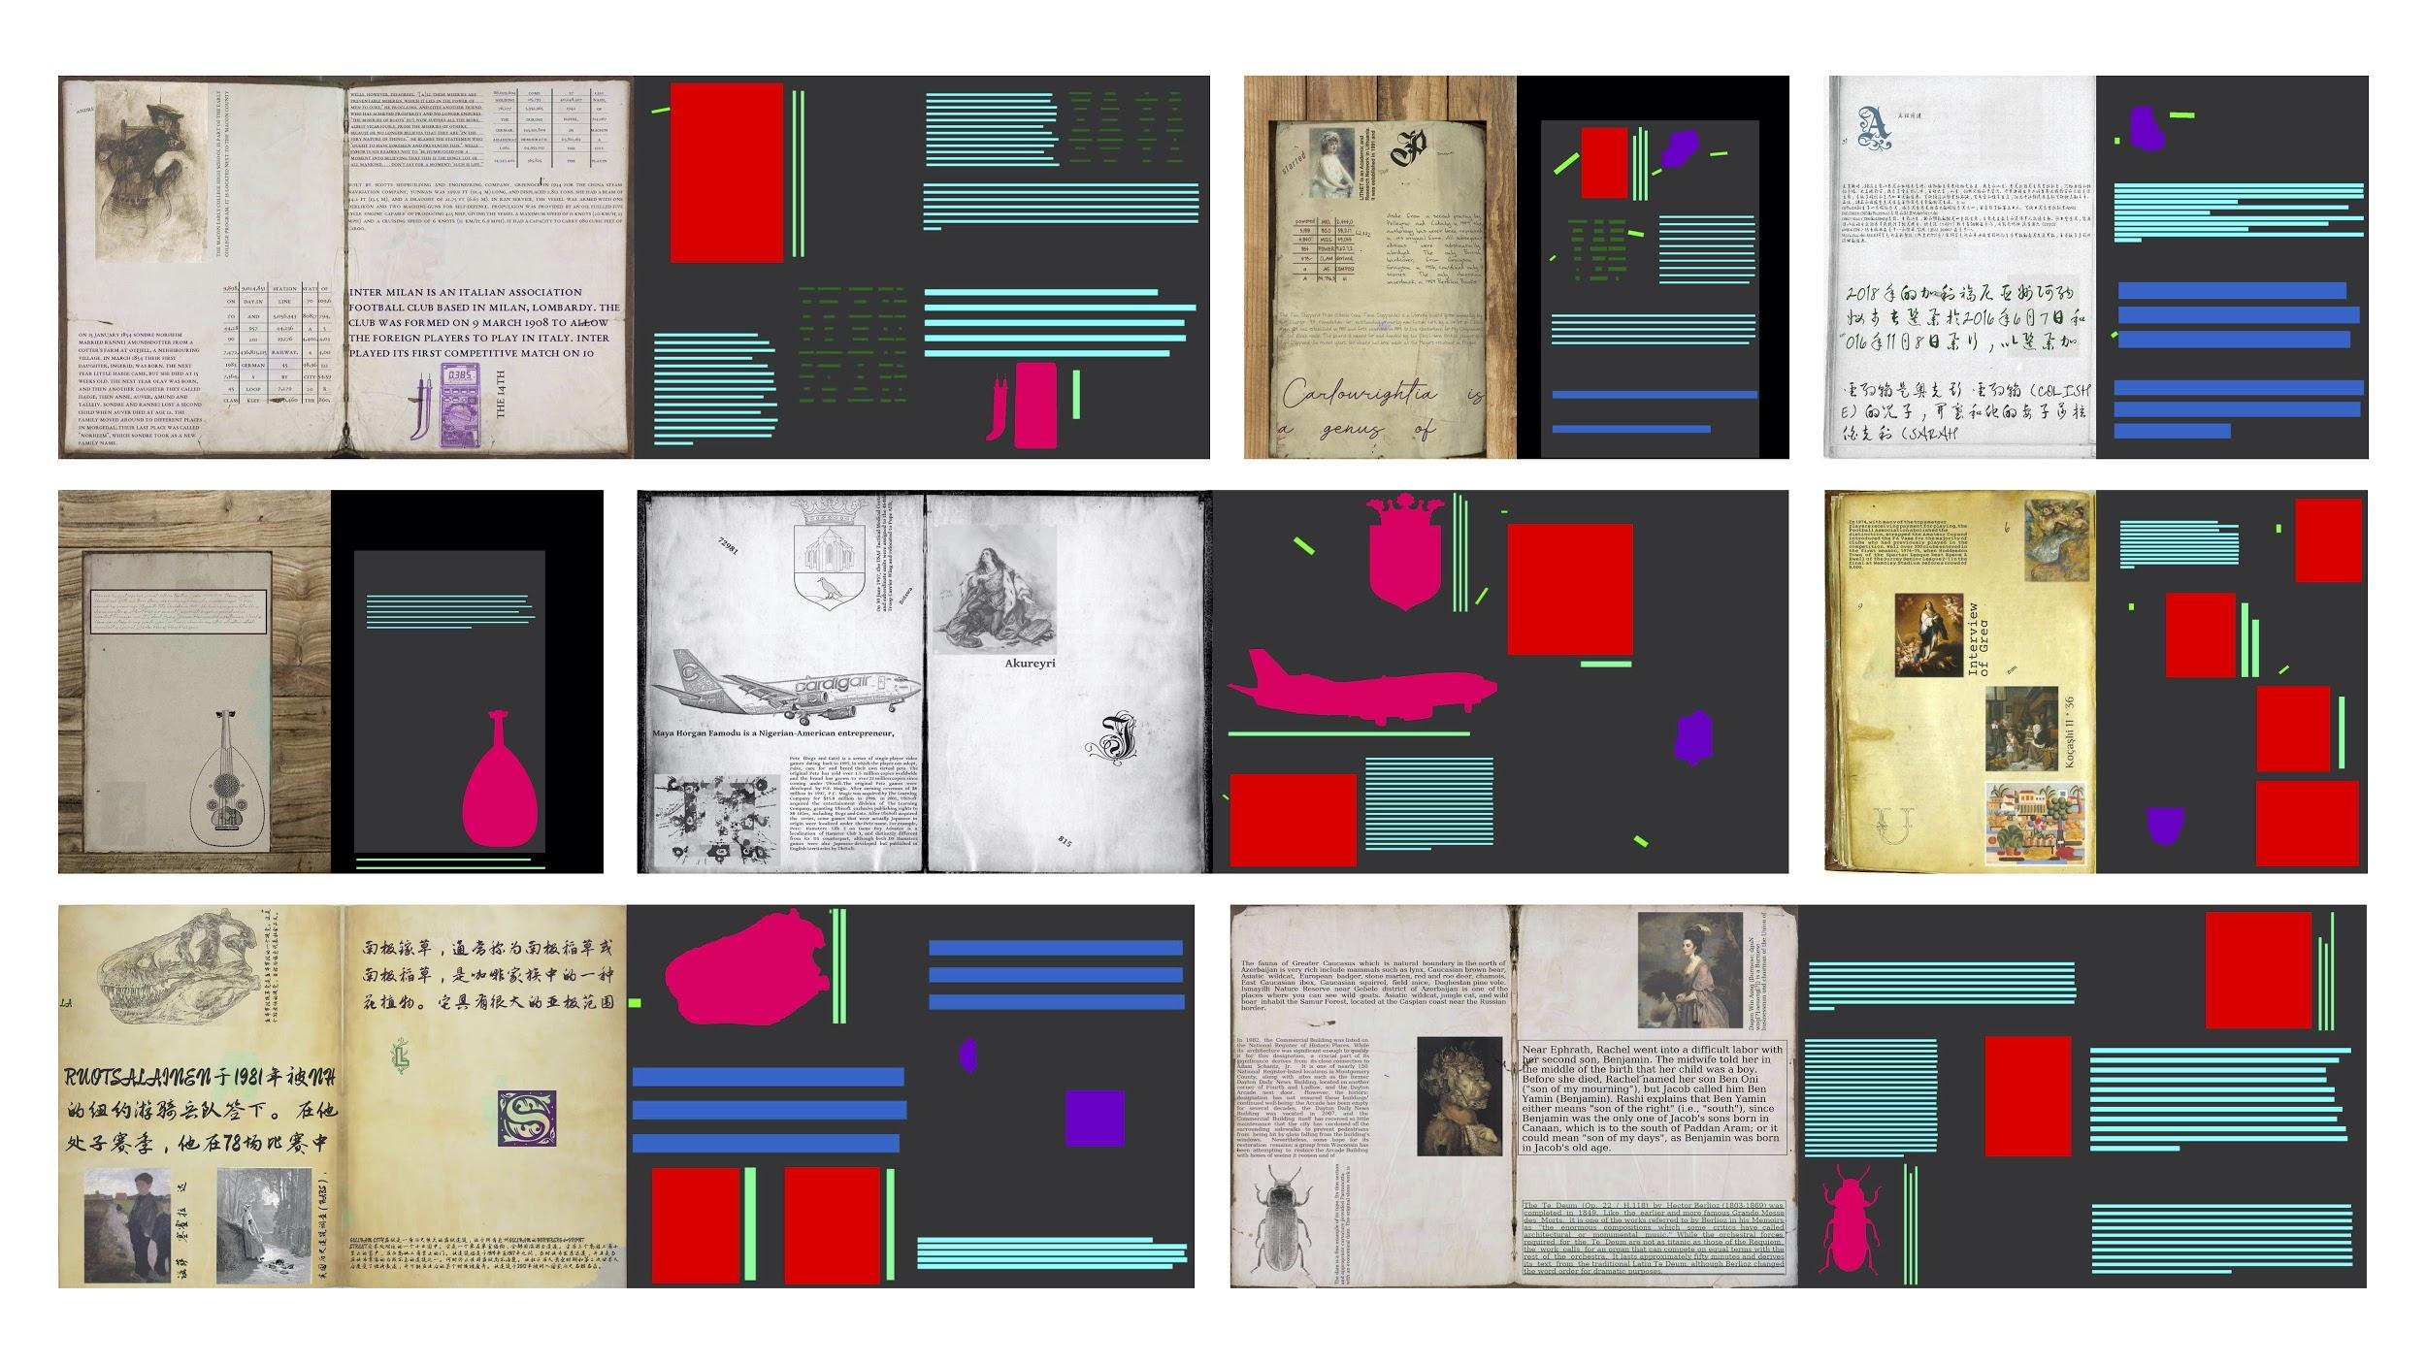
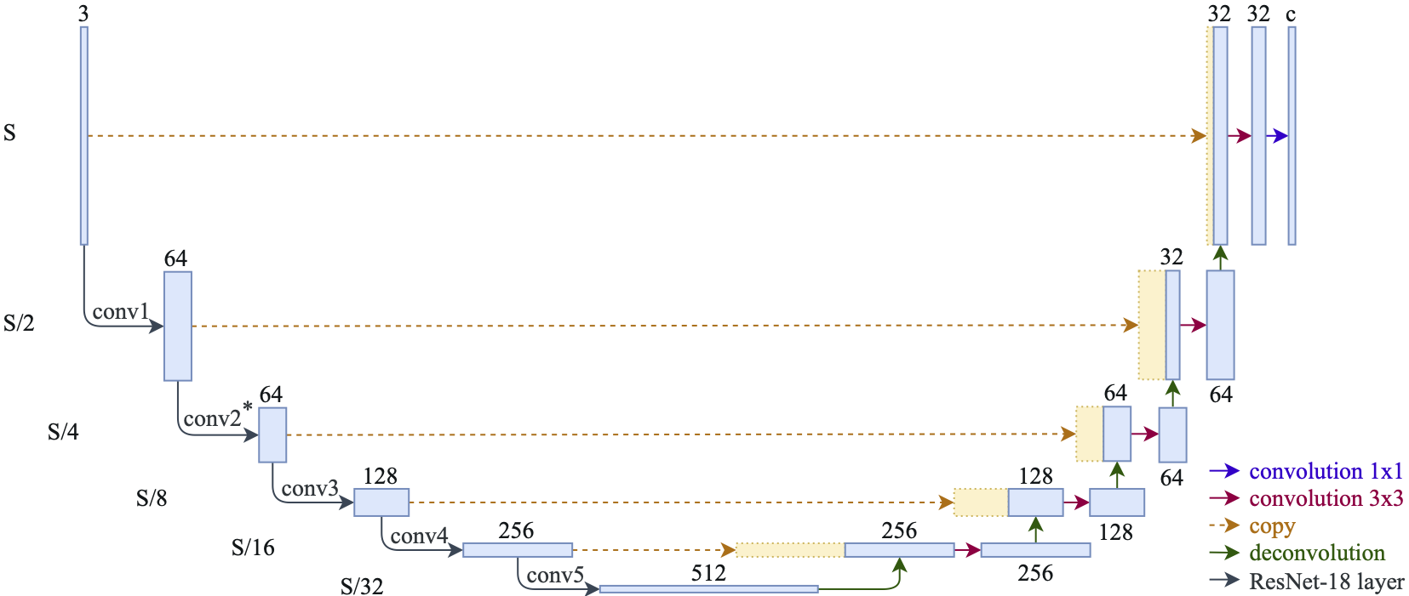
Our approach
Synthetic document generator for line-level page segmentation
Improved U-Net like segmentation network with a ResNet backbone
1
2
Notes:
Our approach relies on two key elements: a synthetic document generator designed for line-level page segmentation and an improved U-Net like segmentation network with a ResNet backbone. I am now going to detail the generation pipeline.

Slide 12
Synthetic document generation pipeline
1
2
3
Notes:
Our synthetic document generator is a 3-step pipeline, each of the steps being fully randomized.

Slide 13
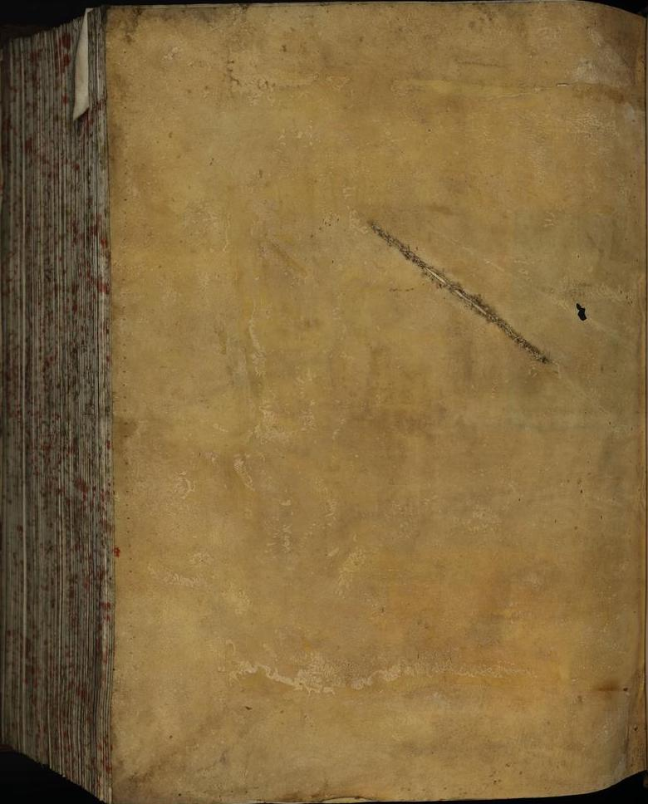
Synthetic document generation pipeline
1
Background composition
2
3
Notes:
First, we create the background image from a set of empty pages.

Slide 14
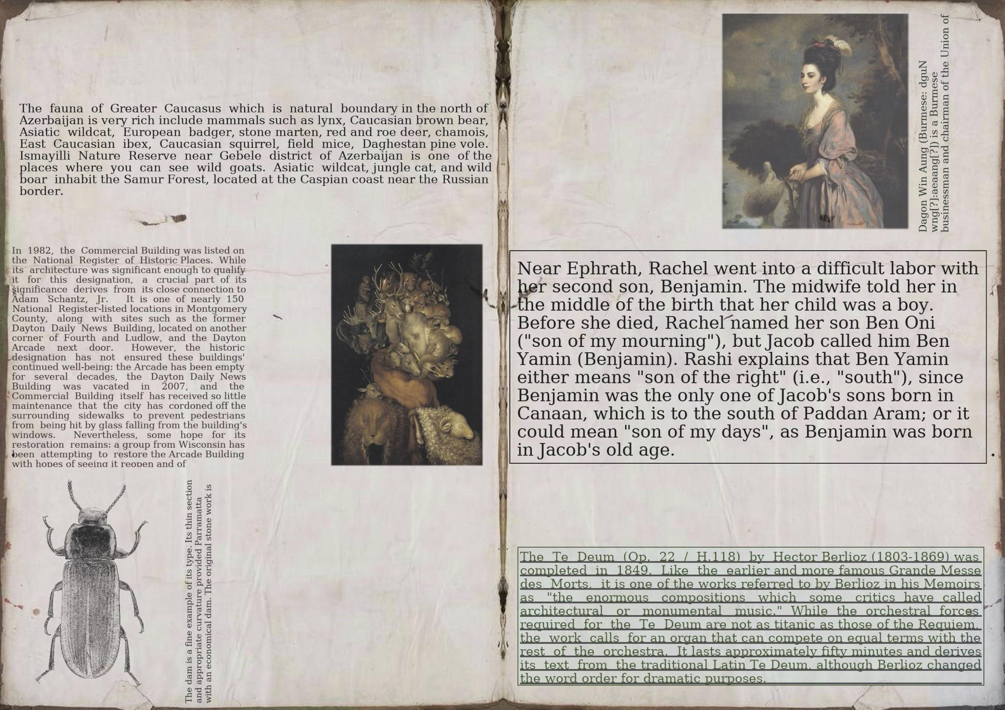
Synthetic document generation pipeline
1
Background composition
2
Content generation
3
Notes:
Then we generate the visual content.

Slide 15
Synthetic document generation pipeline
1
Background composition
2
Content generation
3
Noise addition
Notes:
Finally we add noise to the resulting document.

Slide 16
Background composition
177 empty pages
Notes:
For the background composition, we collected 177 empty pages that will serve as base. To create various background images, we designed 3 types of augmentations inspired from real practical cases.

Slide 17
Background composition
177 empty pages
1
Color
Notes:
The page can first be colorized using a uniform color.

Slide 18
Background composition
177 empty pages
1
Color
2
Double page
Notes:
It can be duplicated and mirrored resulting in a double page configuration, which is usually the case for manuscripts.

Slide 19
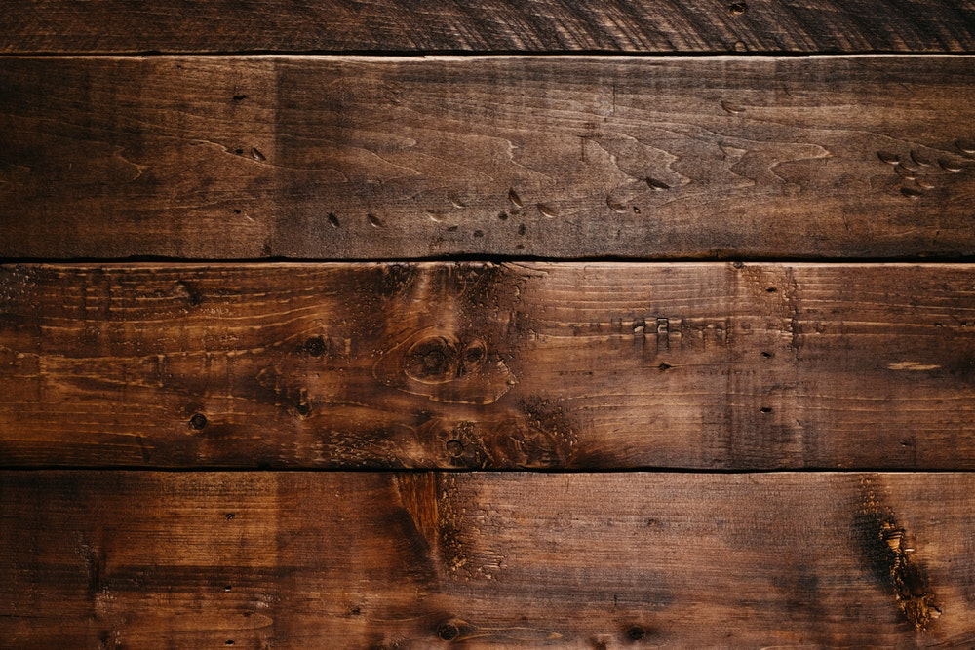
Background composition
177 empty pages
1
Color
2
Double page
3
Contextualization
15 context images
Notes:
Finally, it can be pasted on a context image to mimic some natural scanning processes.

Slide 20
Content generation
Notes:
Starting from a composed background image, we generate the document content in 2 steps:

Slide 21
Content generation
1
Draw layout
Notes:
first, we draw a random layout in the empty pages

Slide 22
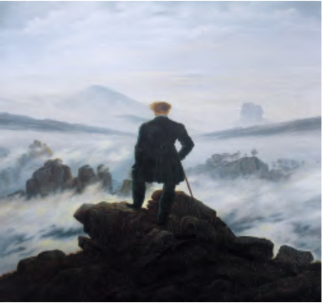
Content generation
1
Draw layout
2
Paste elements
Notes:
Then we generate elements from a defined set of element types and paste them with random margins.

Slide 23
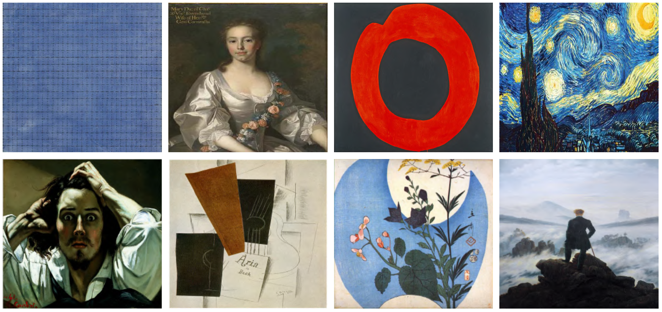
Element types
image: WikiArt dataset (8,1k)
Notes:
We designed 4 element types frequently observed in real datasets. The image type relies on the Wikiart dataset, a 8 thousand images of drawings and paintings which we think to be more challenging than natural image datasets for page segmentation.

Slide 24
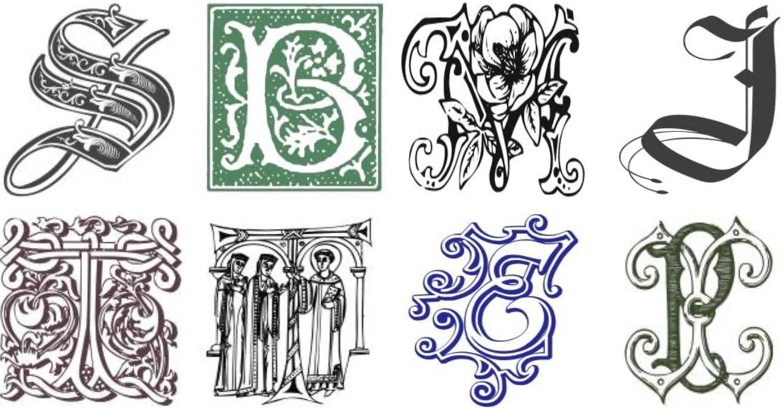
Element types
image: WikiArt dataset (8,1k)
glyph: 91 decorated fonts + random letter
Notes:
The glyph type is an attempt to mimic illuminations found in manuscripts. To generate a glyph, a random letter is drawn and it is rendered using one of the 91 highly decorated fonts we collected.

Slide 25
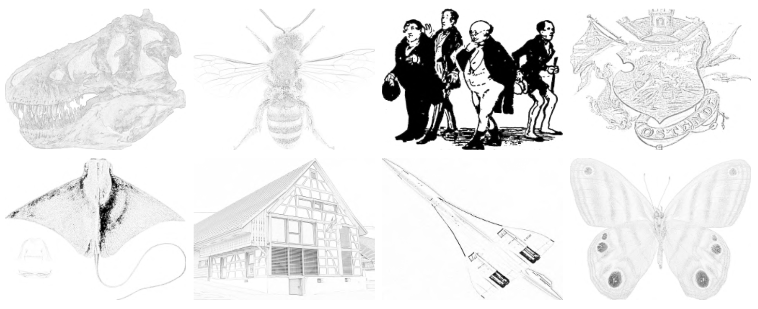
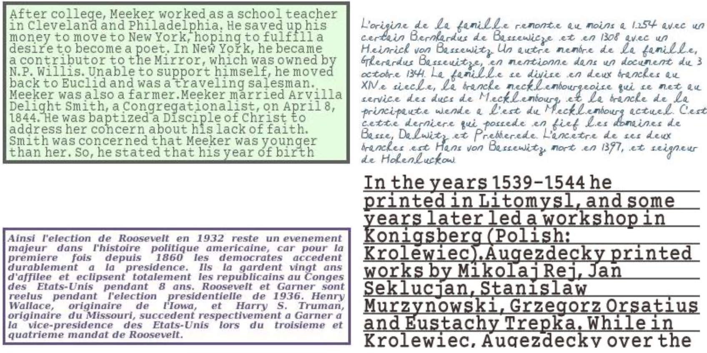
Element types
image: WikiArt dataset (8,1k)
glyph: 91 decorated fonts + random letter
drawing: synthetic drawings from Wikipedia images + augmentations
text: random Wikipedia content + 405 fonts + augmentations
Notes:
The last 2 element types are drawings and texts. Both element types involve more complex generation and labeling processes I am going to detail.

Slide 26
Element types - drawing
Generation
Notes:
As we didn’t find any appropriate drawing datasets, we created synthetic ones from random wikipedia images, for example here, a plane.

Slide 27
Element types - drawing
Generation
1
Line detection
Notes:
We first apply a line detection algorithm that results in a raw drawing

Slide 28
Element types - drawing
Generation
1
Line detection
2
Augmentations
(contrast, color, blur)
Notes:
Then at generation time, we apply image augmentations to get more various drawings

Slide 29
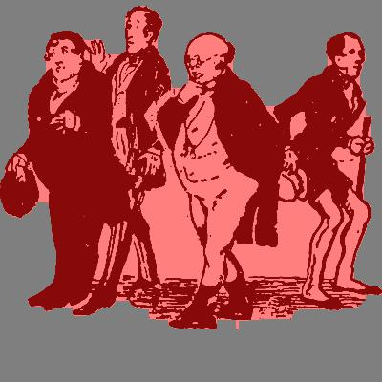
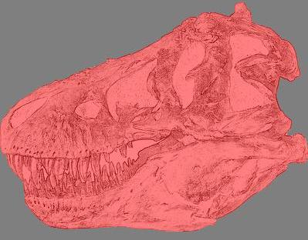
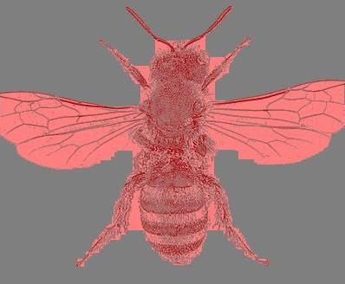
Element types - drawing
Generation
Labeling = bounding shapes
(with closing operations)
1
Line detection
2
Augmentations
(contrast, color, blur)
Notes:
For the labeling, we chose bounding shapes computed using closing operations as we believe they generalize better than bounding boxes or contours.

Slide 30
Element types - text
405 fonts downloaded from the web
Random text from Wikipedia
5 layout constraints
caption, floating-word, paragraph, table, title
(line length, font size, position, rotation, ...)
Notes:
To generate text, we collected more than 400 fonts including handwritten ones and scraped text from wikipedia pages. We defined 5 layout constraints corresponding to different elements, which include parameters such as line length, font size and relative position.

Slide 31
Element types - text
405 fonts downloaded from the web
Hello World!
Random text from Wikipedia
5 layout constraints
caption, floating-word, paragraph, table, title
(line length, font size, position, rotation, ...)
Notes:
By combing these 3 aspects, we can render varied text contents.

Slide 32
Element types - text
H e l l o W o r l d !
405 fonts downloaded from the web
你好，世界!
Hello World!
Hello World!
Hello World!
Random text from Wikipedia
5 layout constraints
caption, floating-word, paragraph, table, title
(line length, font size, position, rotation, ...)
strike through, justification, ...
Notes:
To increase the diversity, we apply text augmentations including formatting, text translation, underlining or bounding box addition.

Slide 33
Element types - text
H e l l o W o r l d !
405 fonts downloaded from the web
你好，世界!
Hello World!
Hello World!
Hello World!
Random text from Wikipedia
5 layout constraints
caption, floating-word, paragraph, table, title
(line length, font size, position, rotation, ...)
strike through, justification, ...
Labeling = x-height + border
Notes:
We chose to label our text lines using the x-height representation and a border region as shown in cyan and orange.

Slide 34
Element types - text
H e l l o W o r l d !
405 fonts downloaded from the web
你好，世界!
Hello World!
Hello World!
Hello World!
Random text from Wikipedia
5 layout constraints
caption, floating-word, paragraph, table, title
(line length, font size, position, rotation, ...)
strike through, justification, ...
Labeling = x-height + border
Notes:
This choice is different from other popular text representations such as baselines or bounding boxes. Indeed, we believe it enables straight forward text line extraction while preventing as much as possible overlapped line labels.

Slide 35
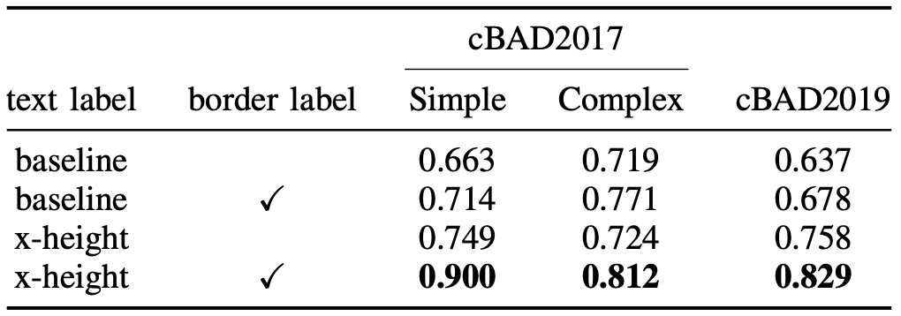
Element types - text
H e l l o W o r l d !
405 fonts downloaded from the web
你好，世界!
Hello World!
Hello World!
Hello World!
Random text from Wikipedia
5 layout constraints
caption, floating-word, paragraph, table, title
(line length, font size, position, rotation, ...)
strike through, justification, ...
Labeling = x-height + border
x-height generalizes better & borders increase perf
Notes:
We empirically show that x-height representation generalizes much better to unseen data than baselines and that adding border labels dramatically increase performances in both scenarios.

Slide 36
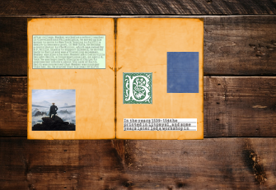
Noise addition
Notes:
The last step of our generation pipeline is to add noise. We implemented 3 types of noise.

Slide 37
Noise addition
1
Gaussian blur
Notes:
A gaussian blur can be applied to the whole image.

Slide 38
Noise addition
1
Gaussian blur
2
Structured noise
(lines or random shapes)
Notes:
Structured noises such as lines or random shapes can be added.

Slide 39
Noise addition
1
Gaussian blur
2
Structured noise
(lines or random shapes)
3
Bleed-through
Notes:
Finally, we mimic bleed-through degradation often observed in manuscripts by repeating our content generation step with a very low opacity.

Slide 40
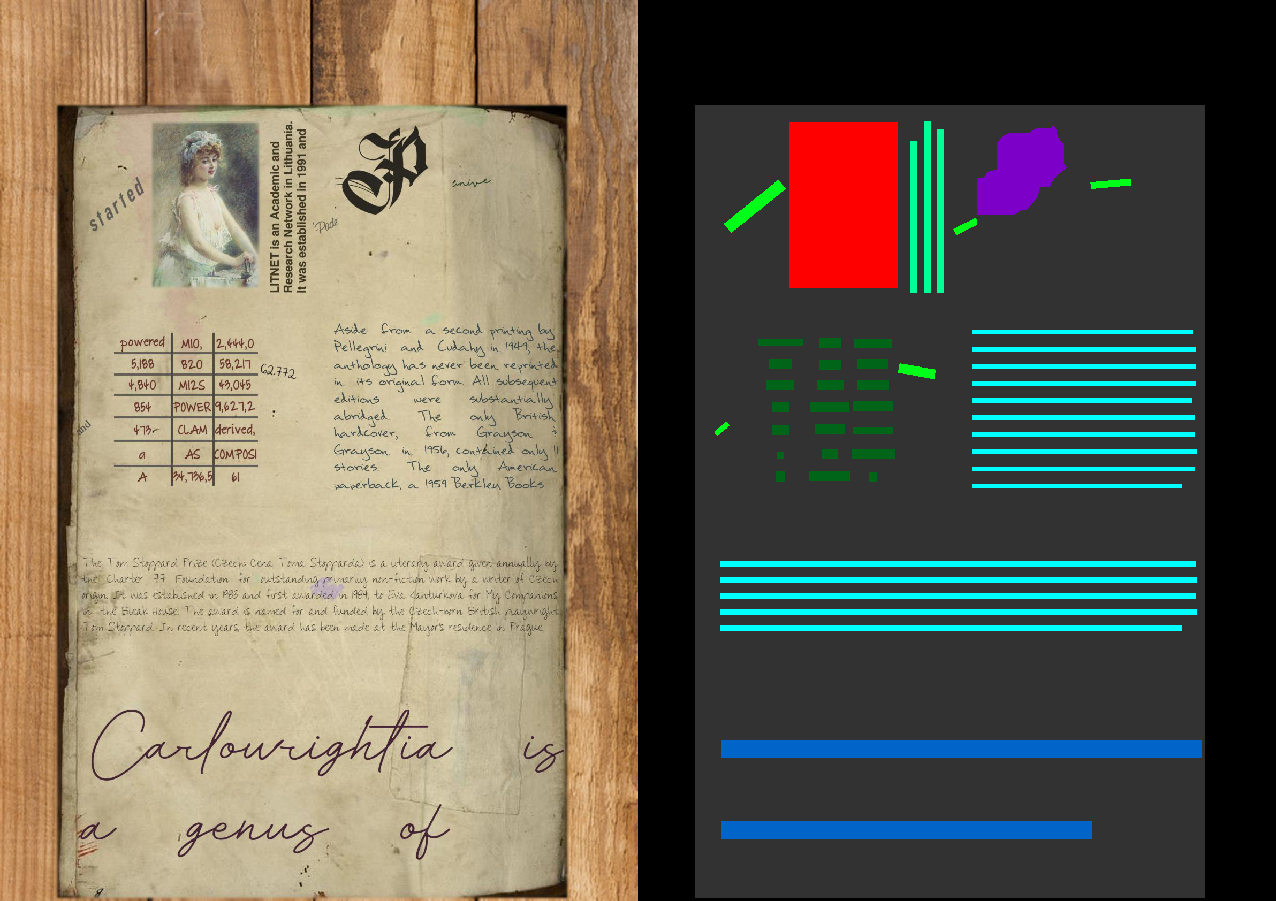
SynDoc examples
Notes:
Using this generator, we have built a 10 thousand images dataset that we called SynDoc. Here is an example which contains most of the implemented features.

Slide 41
SynDoc examples
Notes:
The page background has been pasted on a wood context image

Slide 42
SynDoc examples
Notes:
There are 2 paragraphs in english which are colored and justified.

Slide 43
SynDoc examples
Notes:
There is a 3-column table filled with words and numbers.

Slide 44
SynDoc examples
Notes:
The title at the bottom has been rendered using an handwritten-like font.

Slide 45
SynDoc examples
Notes:
There is also a vertical caption next to the image ...

Slide 46
SynDoc examples
Notes:
And 5 floating words are drawn at the top of the page.

Slide 47
SynDoc examples
Notes:
Finally, there is a single image that lies ...

Slide 48
SynDoc examples
Notes:
Next to a glyph depicting the letter P.

Slide 49
SynDoc examples
Notes:
Here is a batch of examples extracted from our SynDoc dataset. Note how diversified the documents are. I am now going to detail our method.

Slide 50
Segmentation method
Network = U-Net with ResNet-18 backbone
* indicates max-pooling replacement with conv3x3
Notes:
We tackle generic element extraction as a line-level page segmentation task. We used a U-Net with a ResNet-18 backbone optimized with standard cross entropy loss.

Slide 51
Segmentation method
Network = U-Net with ResNet-18 backbone
* indicates max-pooling replacement with conv3x3
Notes:
We made two minor modifications in the raw architecture. We first replaced the max-pooling operation in conv2 as it has been shown to lead to gridding artefacts. And we replaced all bilinear upsampling layers by deconvolutions which give better results for small objects like text lines.

Slide 52
Segmentation method
Network = U-Net with ResNet-18 backbone
* indicates max-pooling replacement with conv3x3
Generic post-processing = remove small regions using area threshold
Notes:
We designed a simple and generic post-processing which removes small regions using an area threshold.

Slide 53
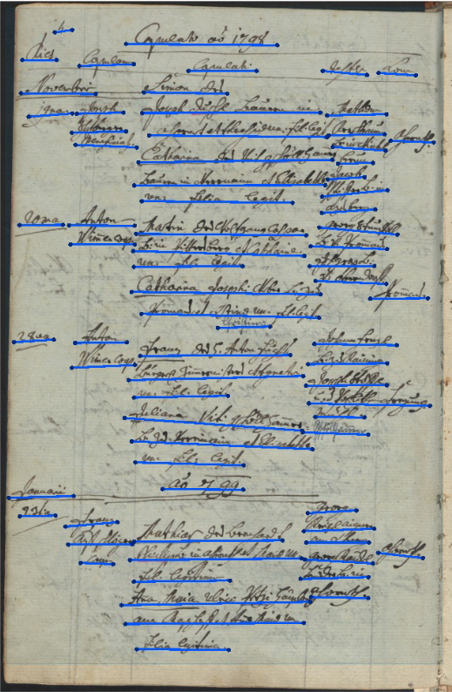
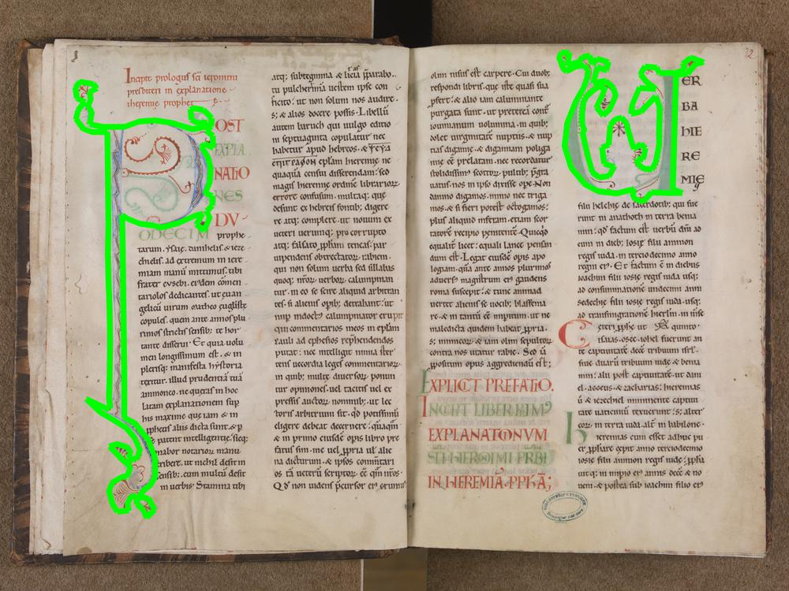
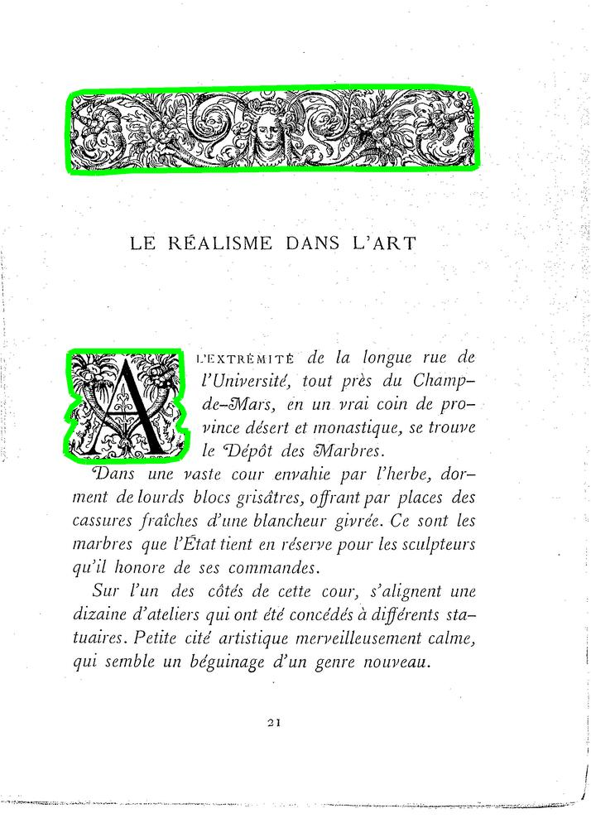
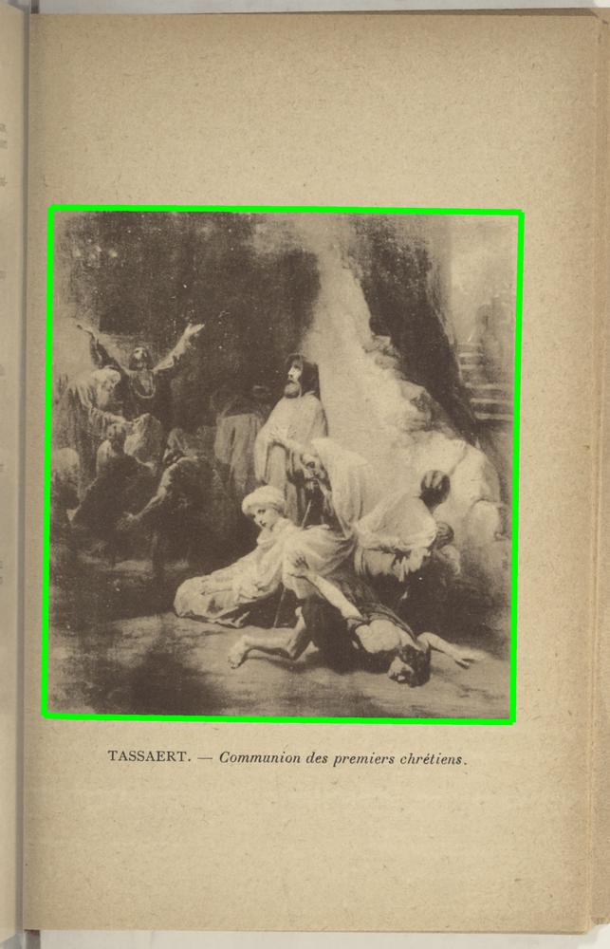
Evaluations
Tasks
Baseline detection:
⇒ cBaD2017 & cBaD2019 datasets
Illustration segmentation:
⇒ Mandragore, RASM2019 & IlluHisDoc (new) with IoU
Notes:
We evaluated our approach for baseline detection on cBAD datasets and illustration segmentation on Mandragore, Rasm2019 and IlluhisDoc.

Slide 54
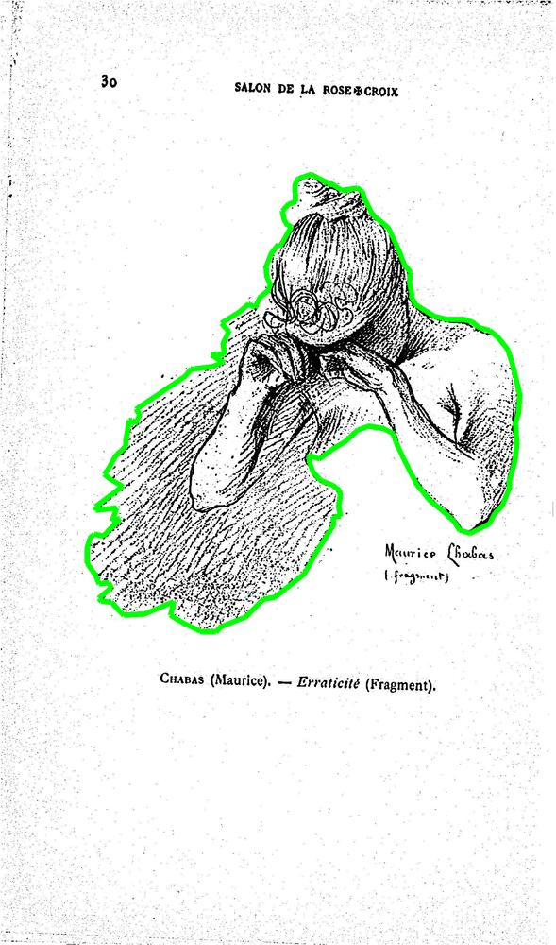
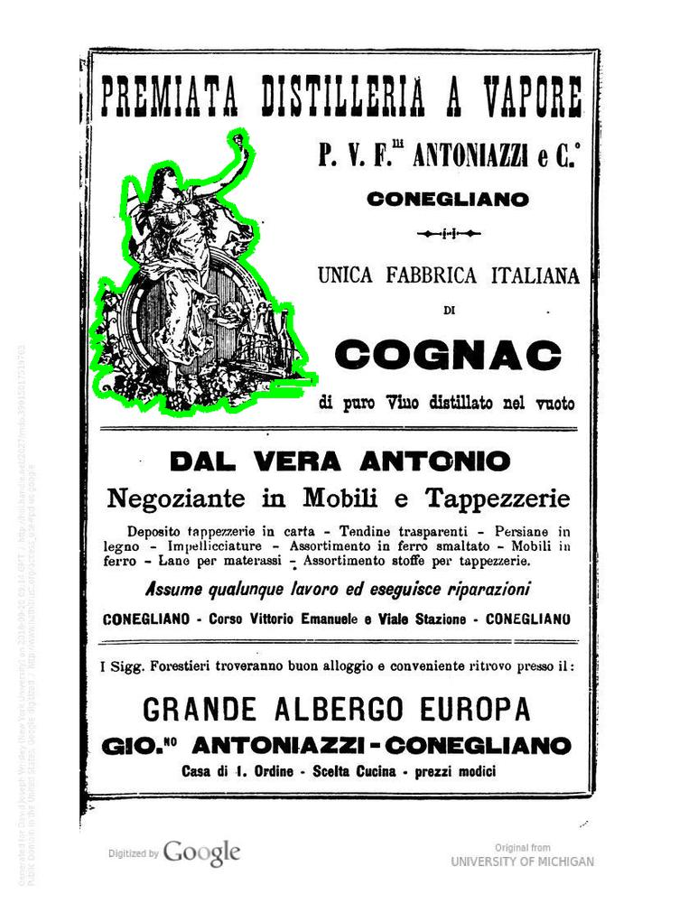
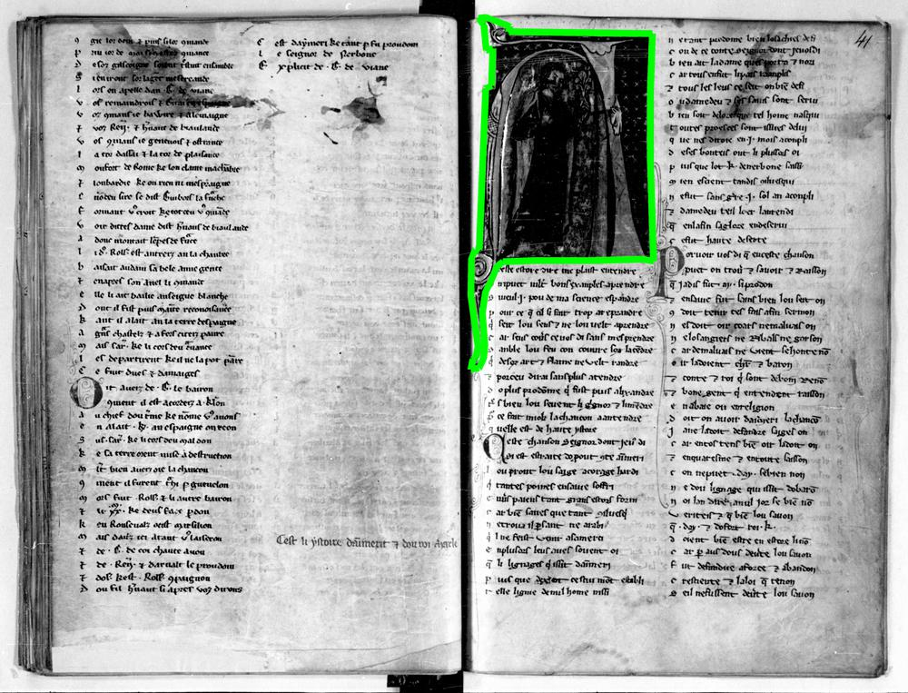
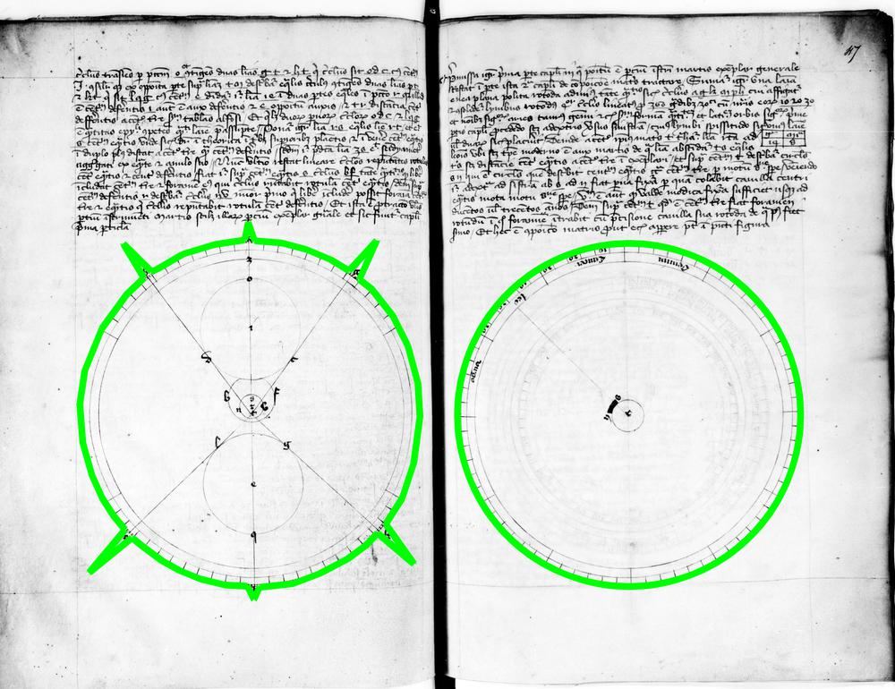
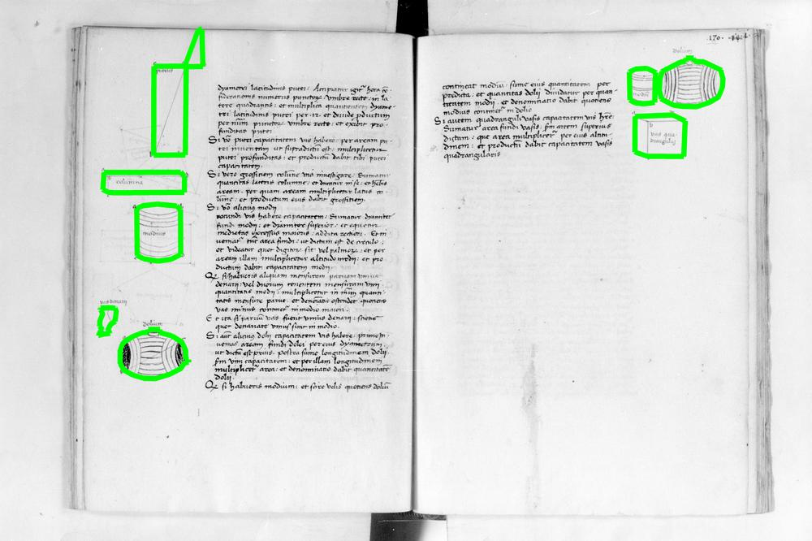
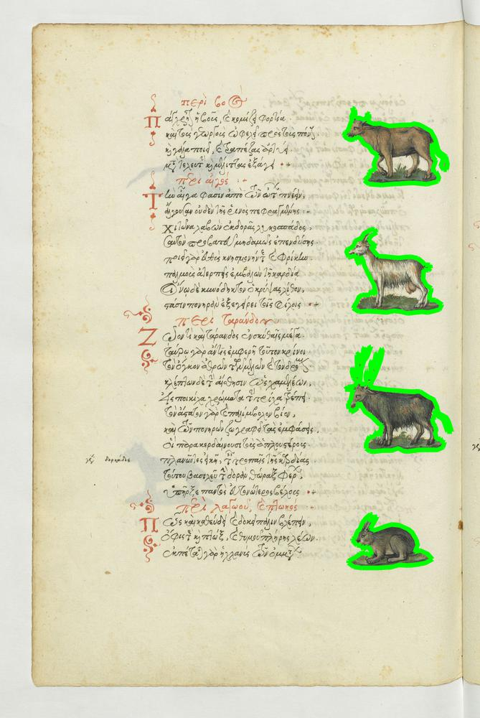
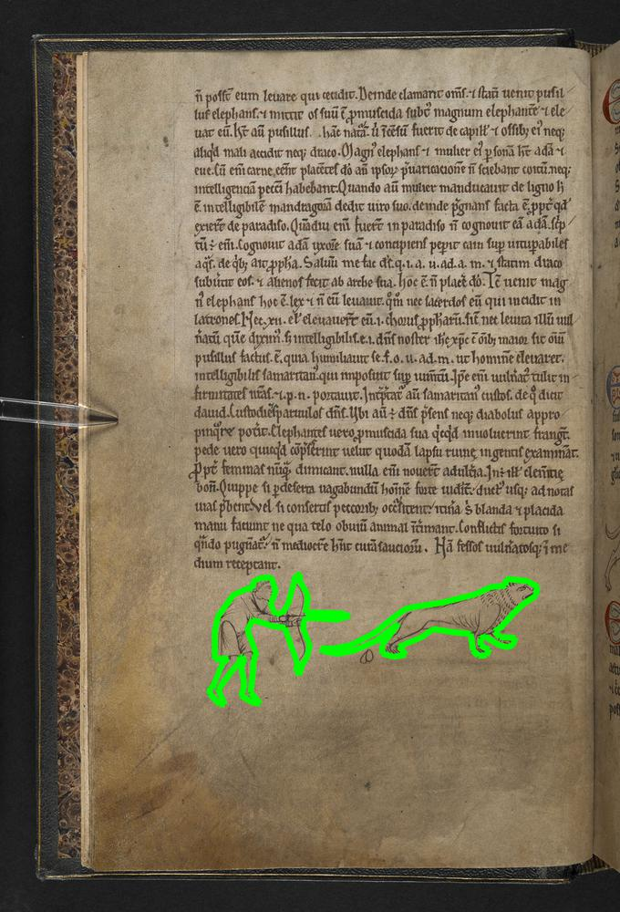
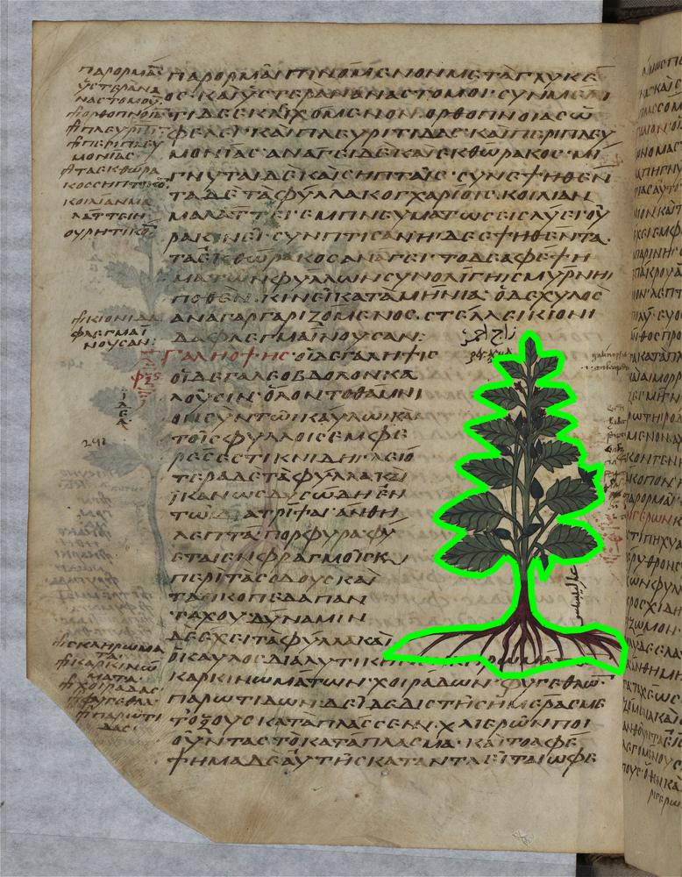
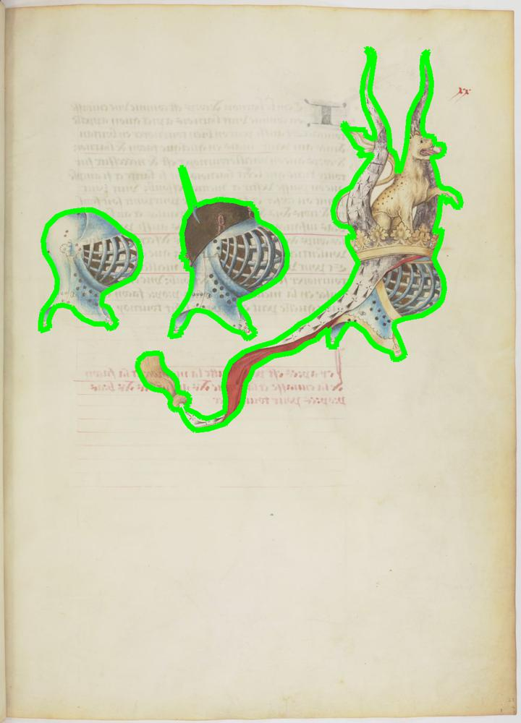
IlluHisDoc dataset
IlluHisDoc = new dataset (400 imgs) for illustration segmentation
Printed documents (P)
Illuminated manuscripts (MSI)
Manuscripts with scientific diagrams (MSS)
Manuscripts with drawings (MSD)
Notes:
IlluHisDoc is a new test dataset for a more representative evaluation of illustration segmentation. It includes diverse types of illustrations and documents are uniformly gathered by categories.

Slide 55
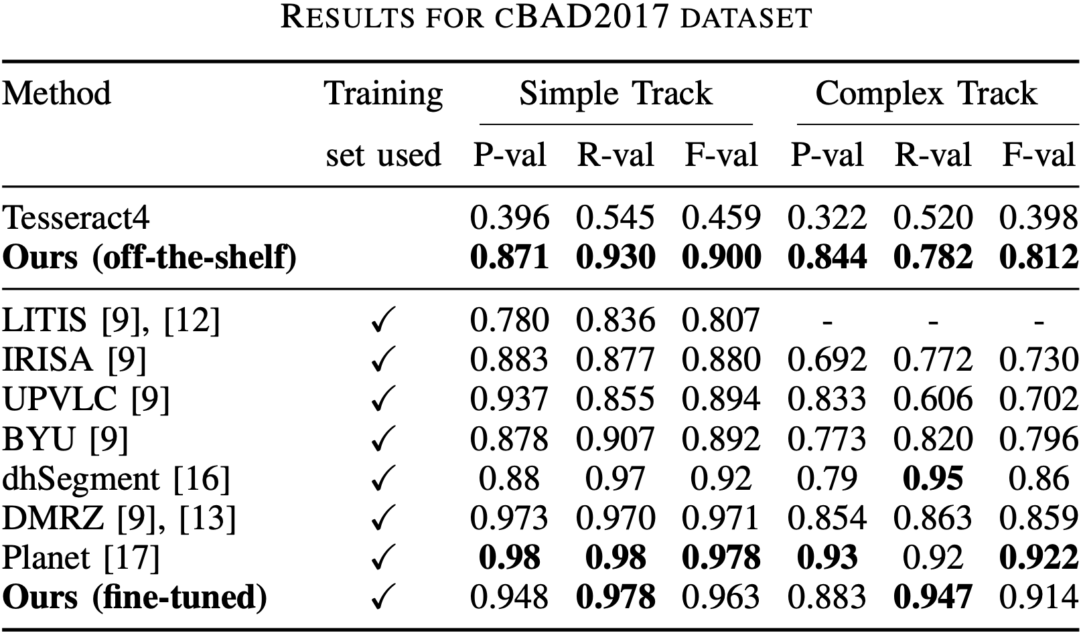
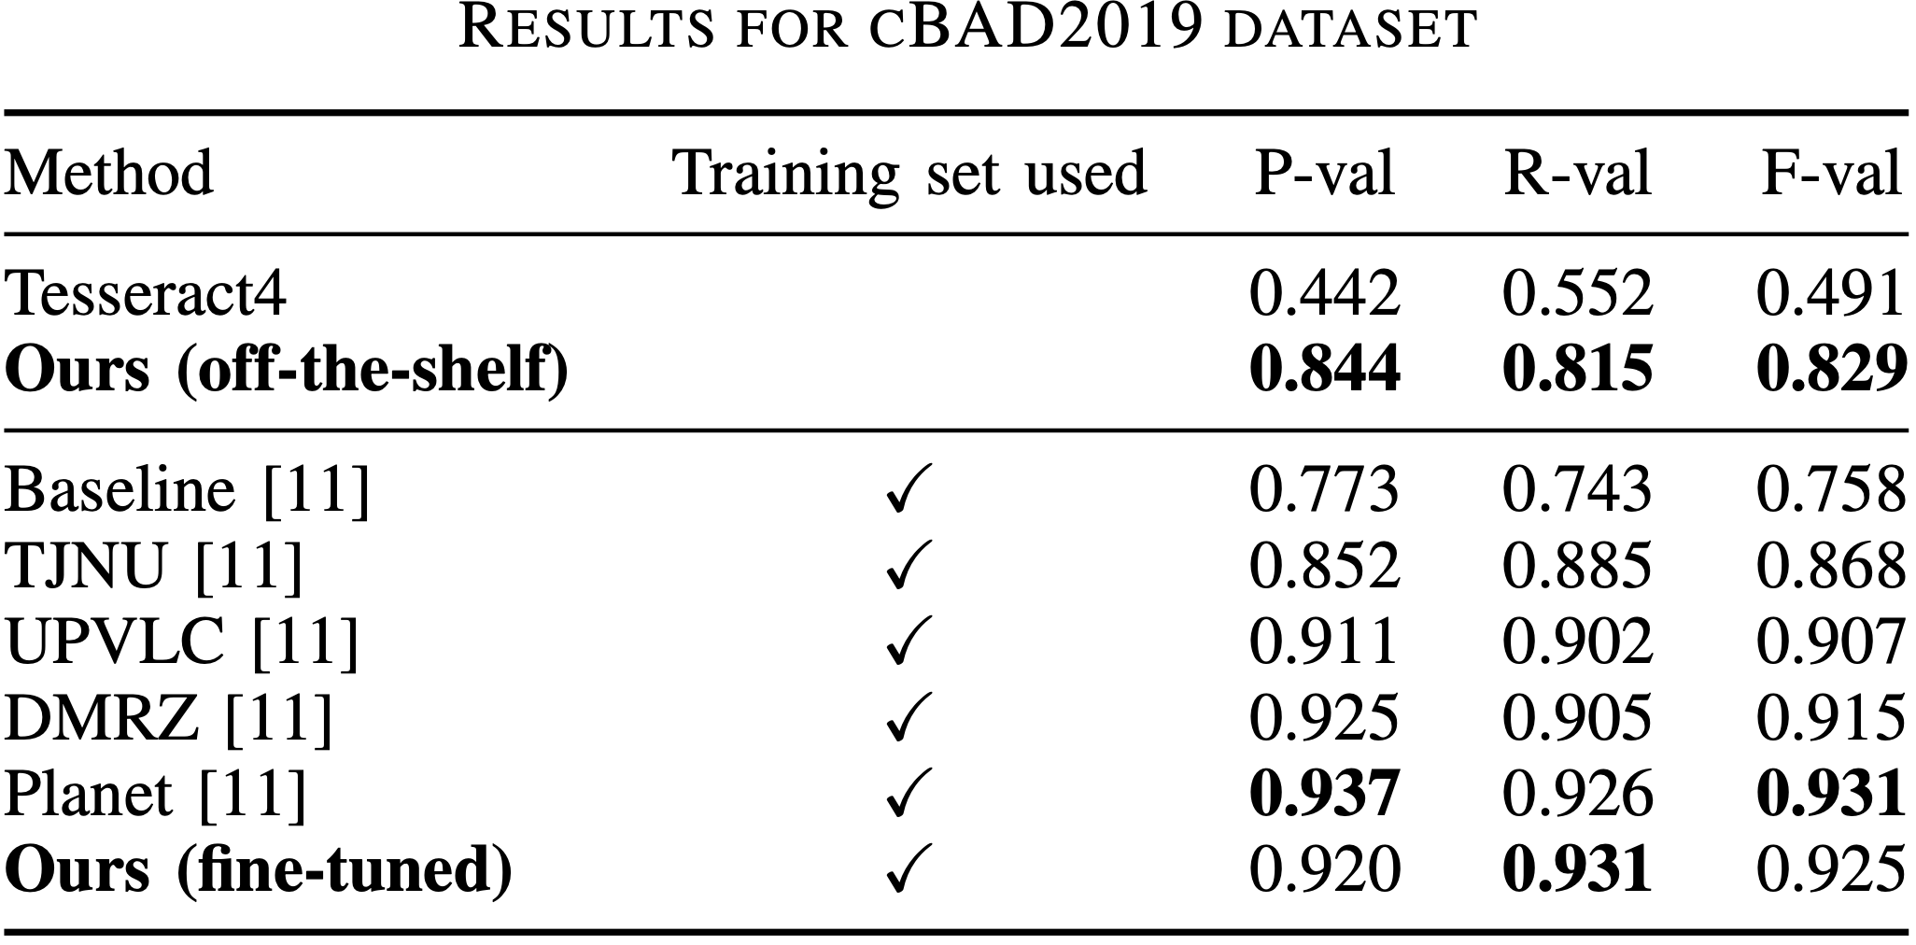
Baseline detection results
Two insights
Notes:
For the baseline detection task, we report results from the popular Tesseract4 as well as concurrent SOTA methods. We can draw two main insights:

Slide 56
Baseline detection results
Two insights
Impressive results with synthetic data only!
Notes:
First, our off-the-shelf approach, that is the method trained on our synthetic documents only, leads to surprisingly good results ! It outperforms Tesseract4 by a large margin and shows results comparable to the weaker methods trained on real data! This demonstrates that our method solely trained on computer-generated data can generalize well to real and complex data.

Slide 57
Baseline detection results
Two insights
Impressive results with synthetic data only!
Using training set leads to results on par with SotA
Notes:
When we fine tune our method on available training sets, our results are on par with state of the art methods. This is a strong result since these methods typically involve very advanced and specific post-processing steps while ours is very simple and common across all datasets and all element types.

Slide 58
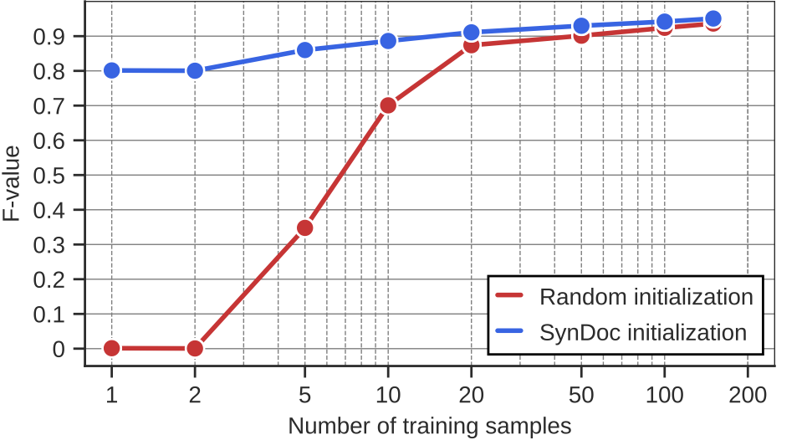
Data-efficient initialization for fine-tuning
Notes:
We believe our off-the-shelf network can also be used as a strong initialization for fine-tuning.To empirically validate it, we initialized our network with both random parameters and parameters trained on SynDoc, and reported the score obtained when training on varying number of samples.

Slide 59
Data-efficient initialization for fine-tuning
SynDoc initialization leads to considerably better results,
with large gaps for less than 20 training samples
Notes:
SynDoc initialization provides much better performances, with large gaps for less than 20 training samples. We believe it is a very valuable result since document annotations are cumbersome and highly time-consuming.

Slide 60
Illustration segmentation results (mIoU)
Two insights
X. Zhong, J. Tang, and A. Jimeno Yepes, “PubLayNet: Largest Dataset Ever for Document Layout Analysis”. In ICDAR, 2019
Notes:
For illustration segmentation, we compare SynDoc to PubLayNet, a large scale dataset of modern synthetic documents and our segmentation method to Mask RCNN, a detection based approach used in the evaluation of PubLayNet. Two main insights can be drawn:

Slide 61
Illustration segmentation results (mIoU)
Two insights
Our segmentation approach provides much better results than detection-based method
X. Zhong, J. Tang, and A. Jimeno Yepes, “PubLayNet: Largest Dataset Ever for Document Layout Analysis”. In ICDAR, 2019
Notes:
First, our segmentation approach gives much better results than Mask RCNN on all benchmarks regardless of the training data.

Slide 62
Illustration segmentation results (mIoU)
Two insights
Our segmentation approach provides much better results than detection-based method
Training on SynDoc provides much better generalization than PubLayNet
X. Zhong, J. Tang, and A. Jimeno Yepes, “PubLayNet: Largest Dataset Ever for Document Layout Analysis”. In ICDAR, 2019
Notes:
Then, training on our synthetic dataset consistently leads to much better generalization than publaynet. This also shows the huge domain gap between modern and historical documents and emphasizes the value of our synthetic dataset for historical document analysis.

Slide 63
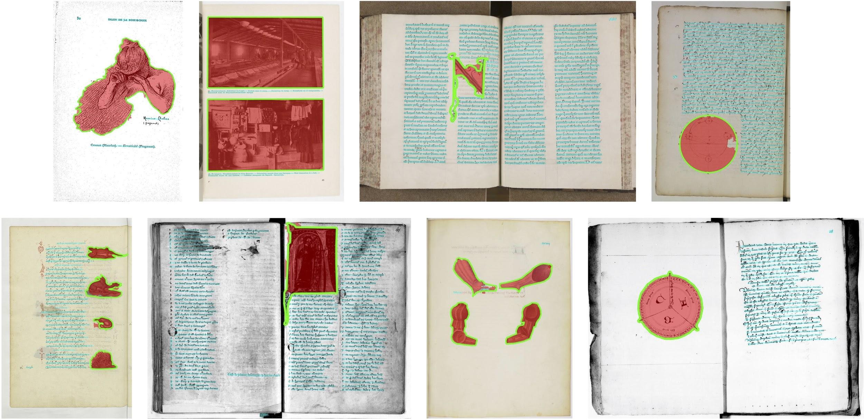
Illustration segmentation results - example
IlluHisDoc
Notes:
We show some qualitative examples on IlluHisDoc. The green contours correspond to the GT and the red and cyan regions corresponds to predicted illustration and text lines.

Slide 64
Illustration segmentation results - example
IlluHisDoc
Notes:
Note how precise our segmentations are even on the finer illustrations.

Slide 65
Web application - demo
https://enherit.paris.inria.fr
Notes:
To demonstrate our approach applicability, we implemented a public web application that automatically annotates visual elements on any document compliant with triple eye F protocole. Here is a quick demo.

Slide 66
Notes:
From a standard Mirador viewer, the user can click on extract button … and fill in a manifest URL to launch the element extraction. From the home window, the user can then look for the corresponding manuscript and select a page to view. The user can toggle annotations and visualize them directly in the viewer. Tags associated to text and images are automatically generated. Annotations are made for all the pages of the documents.

Slide 67
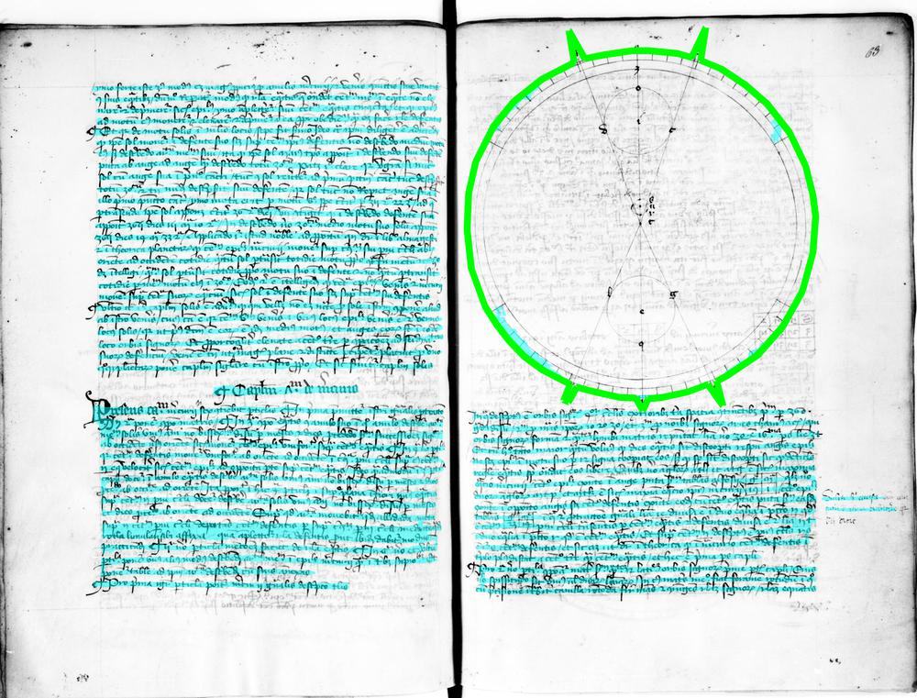
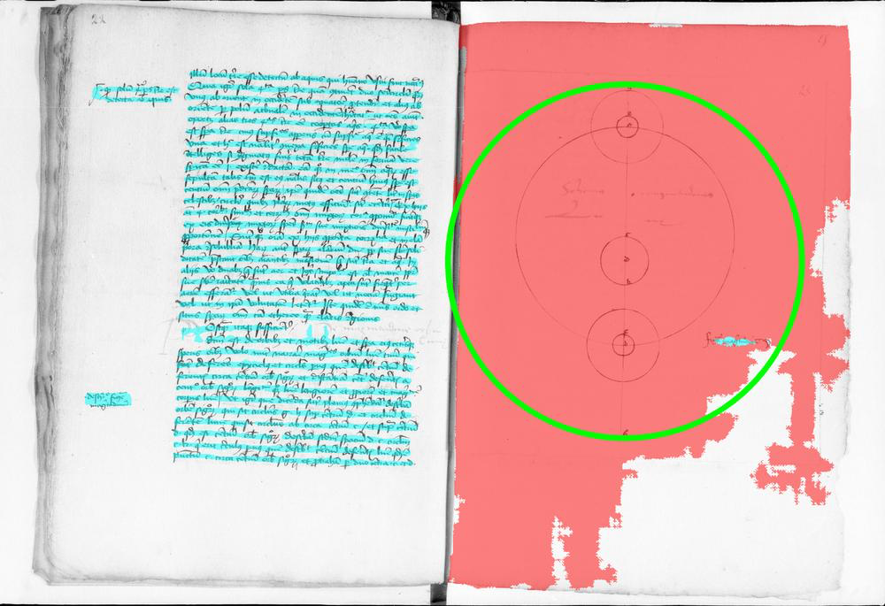
Future work - failure cases
Improve synthetic generation with more elements
and more advanced augmentations!
Notes:
Although our approach can generalize to unseen illustration types (in this case diagrams), performances can be greatly improved by modeling more complex elements and more advanced augmentations. Note that our generation pipeline is specifically designed to easily incorporate new types of elements.

Slide 68
Conclusion
docExtractor
A single and ready-to-use system that leverages synthetic data to efficiently extract text lines and illustrations from real historical documents!
Notes:
To conclude, in this work, we presented docExtractor, a single and ready to use system that leverages synthetic data to efficiently extract text lines and illustrations from real historical documents.

Slide 69
Conclusion
docExtractor
A single and ready-to-use system that leverages synthetic data to efficiently extract text lines and illustrations from real historical documents!
Project webpage: http://imagine.enpc.fr/~monniert/docExtractor/
Code: https://github.com/monniert/docExtractor
Web application: https://enherit.paris.inria.fr
Notes:
Code, models and datasets are online. More information are available at our project webpage.

