Slide 1
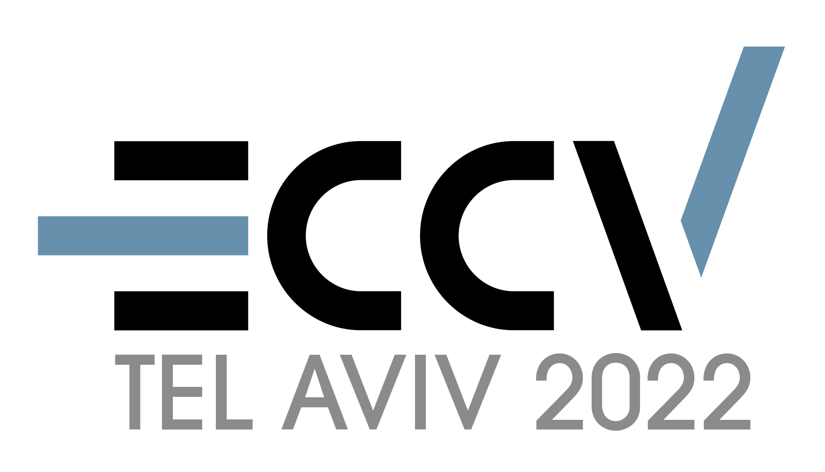
Share With Thy Neighbors: Single-View Reconstruction by Cross-Instance Consistency
Tom Monnier¹ Matthew Fisher² Alexei A. Efros³ Mathieu Aubry¹
1 2 3
Notes:
Hi, I am Tom and I will present our paper share with thy neighbors: single-view reconstruction by cross instance consistency.

Slide 2
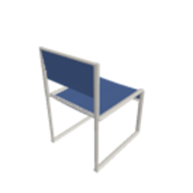
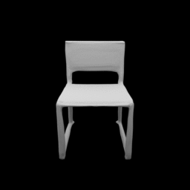
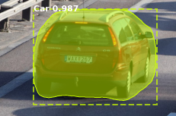
[1] Soft Rasterizer, Liu et al., 2019
[2] DVR, Niemeyer et al., 2020
[6] IMR, Tulsiani et al., 2020
[7] UMR, Li et al., 2020
[8] UCMR, Goel et al., 2020
[9] SMR, Hu et al., 2021
[3] CMR, Kanazawa et al., 2018
[4] SDF-SRN, Lin et al., 2020
[5] TARS-3D, Duggal and Pathak, 2022
OccNet, Mescheder et al., 2019
Supervision =
limited applicability
Pavllo et al., 2021
Notes:
The goal of single-view reconstruction is to output the 3D model depicted by a single image
Despite efforts to reduce supervision, the most advanced methods still rely on:
multiple views and camera poses for ShapeNet,
silhouettes and assumptions like symmetry or known template shapes for real-images
By design, such supervision is limiting the applicability because
annotations can either be unknown or coarse
template shapes are not always available
abd the symmetry hypothesis can be not valid

Slide 3
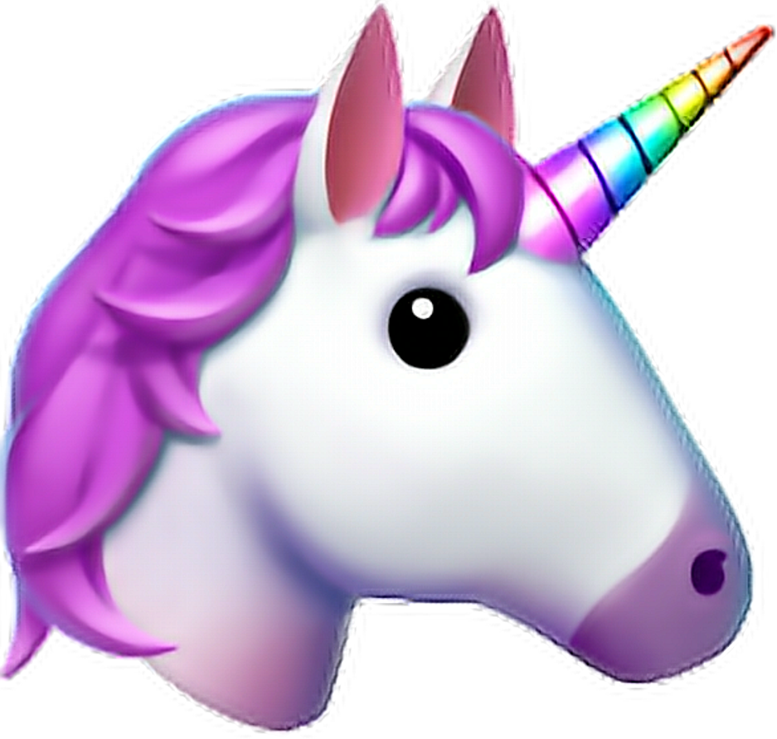
UNICORN
Cross-instance consistency
Notes:
In this work, our goal is to learn a system from raw images of an object category, without any further assumption.
Our key insight to avoid supervision is to leverage the consistency across different instances.
Our system called UNICORN is able to produce highly competitive results on diverse shapes from ShapeNet, as well as on real-images.

Slide 4
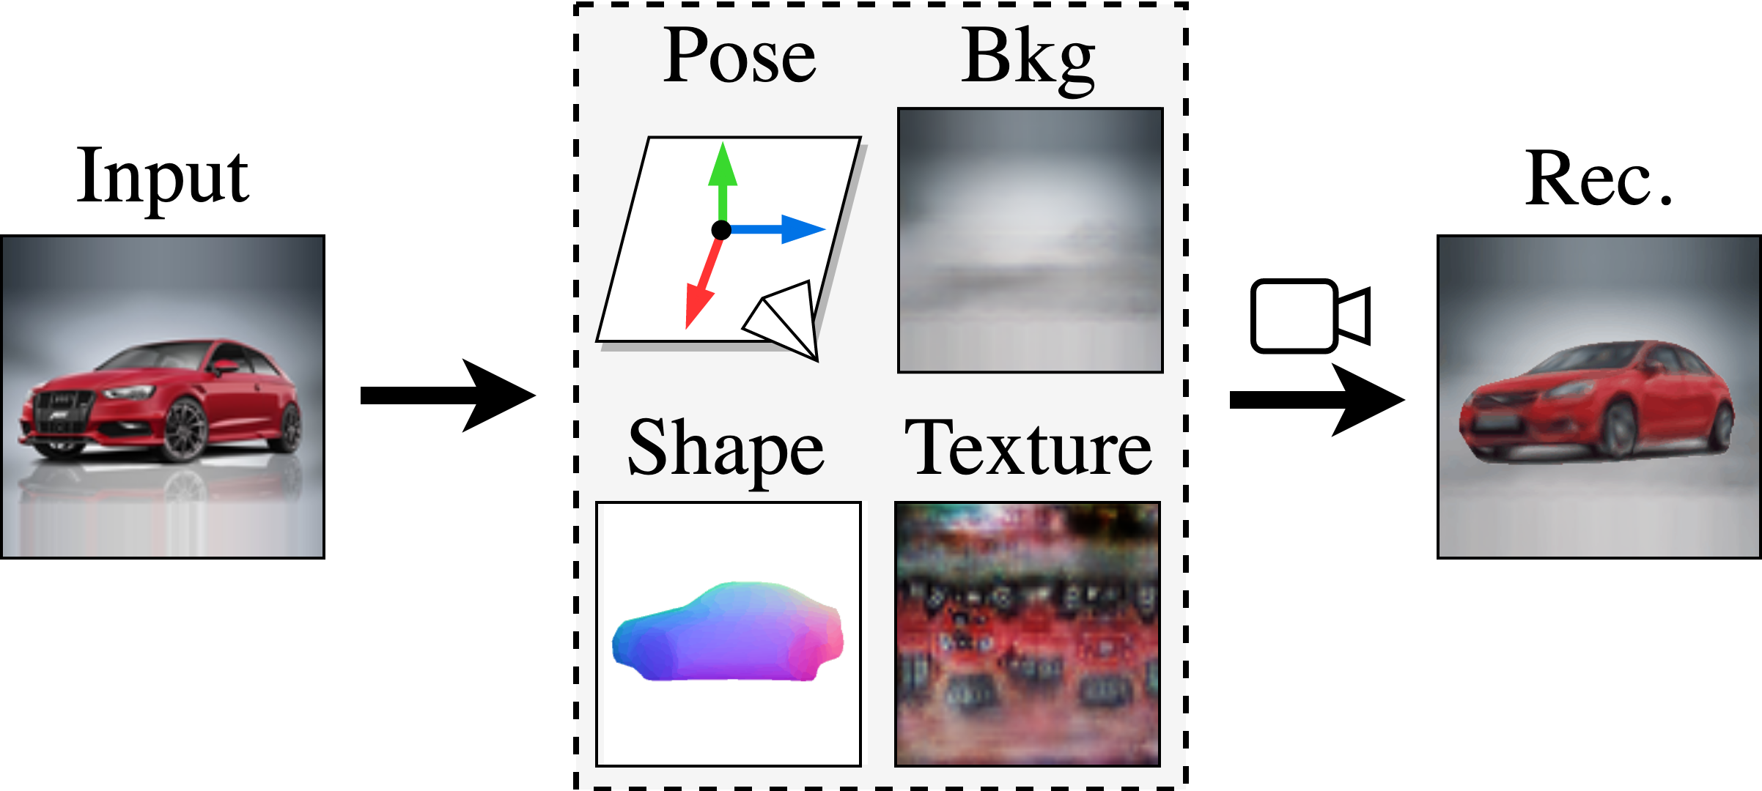
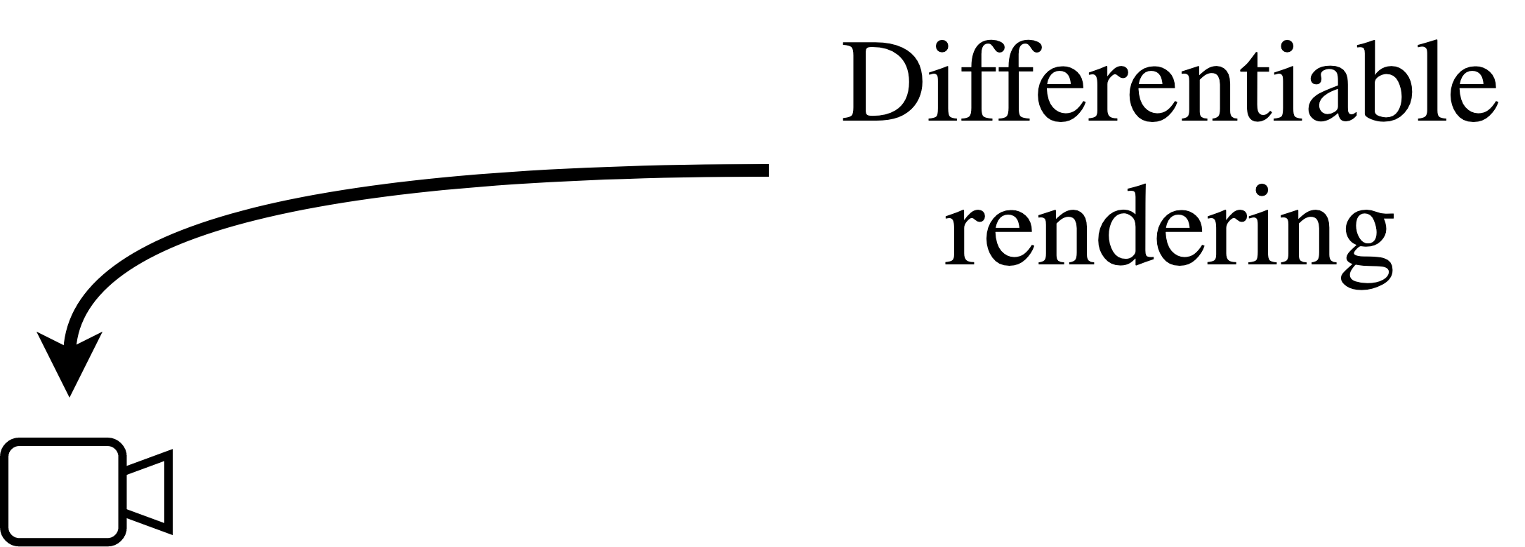
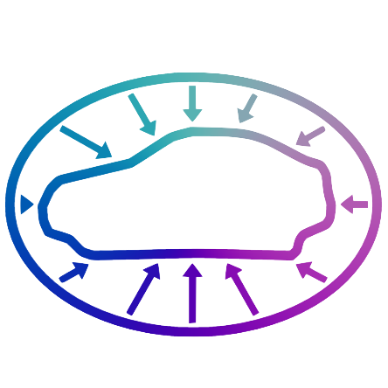
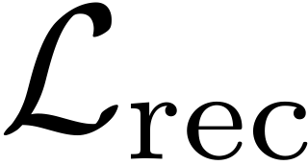
Learning by raw image auto-encoding
Model is over-parameterized / highly unconstrained!
Notes:
We approach this unsupervised learning problem as an image auto-encoding task,
where factors related to shape, texture, pose and background are modeled.
Specifically, the decoding part corresponds to the differentiable rendering of a mesh over a background image
Such a model is over-parameterized and is prone to degenerate solutions
For example, the background model can overfit the input image
Or the 3D can be completely wrong despite a rendering from the input view being correct

Slide 5
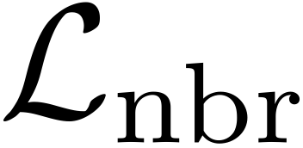
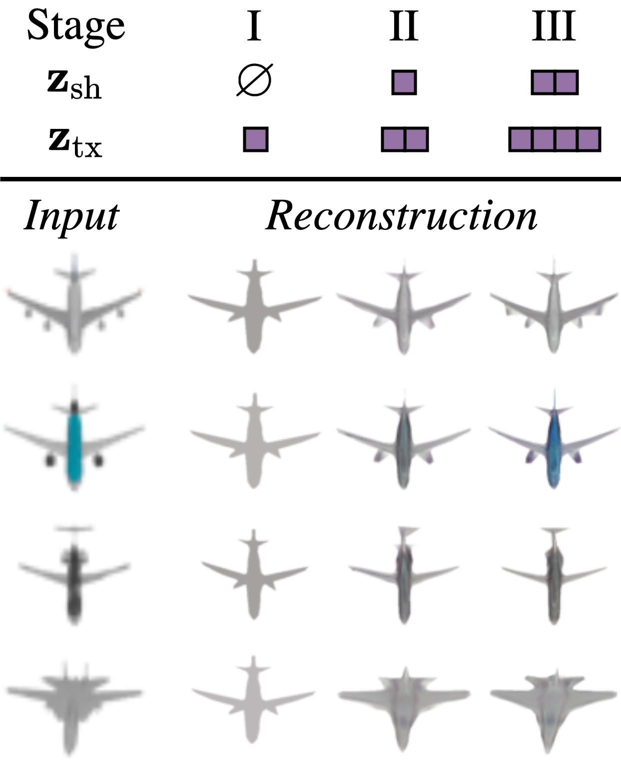
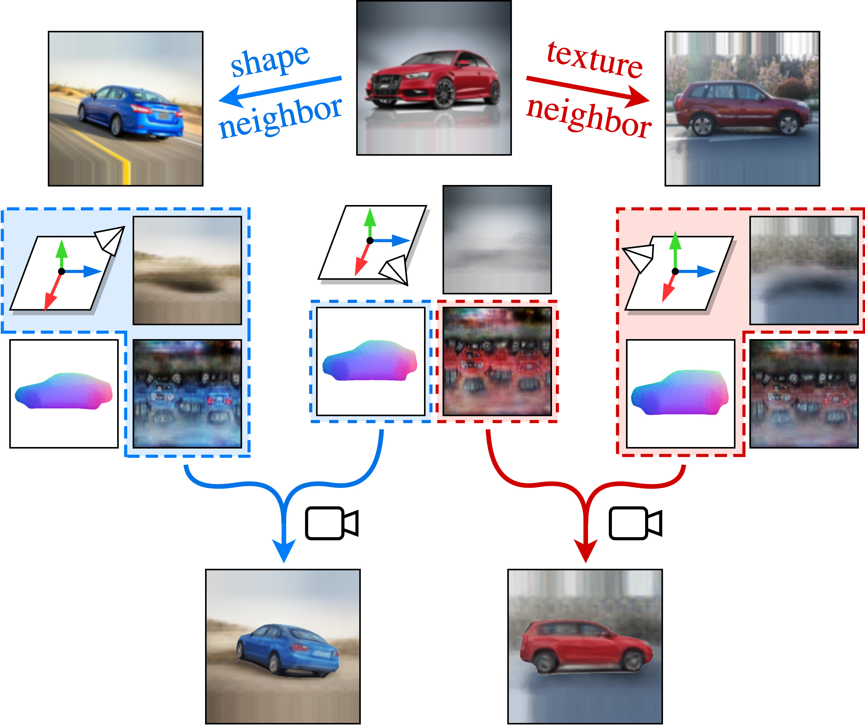
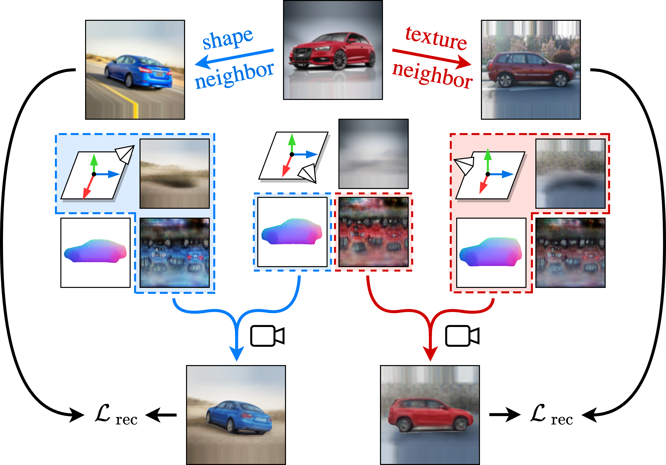
Leveraging the consistency across instances
Progressive conditioning (PC)
Neighbor reconstruction
Notes:
We design two data-driven approaches to leverage cross-instance consistency at its best during training.
First, we introduce a curriculum learning technique consisting in progressively increasing the size of the conditioning space in a multi-stage fashion.
At the beginning of training, small latent spaces force representations to be shared across a significant subset of instances.
Then, this provides a good starting point to gradually specialize to specific instances
by increasing the latent space dimension.
Intuitively, this is a pragmatic solution to learn from an over-parametrized model.
Second, given an input image and its predicted attributes, we introduce a loss operating on custom reconstructions of neighbors that have different viewpoints. Specifically,
Given a shape neighbor with a different pose, we build its reconstructed image using the shape attribute of the input instead.
Similarly, we repeat the process with the texture attribute.
By applying a reconstruction loss on these output, this simple technique explicitly enforces attributes to be consistent across different viewpoints and thus prevents degenerate solutions.

Slide 6
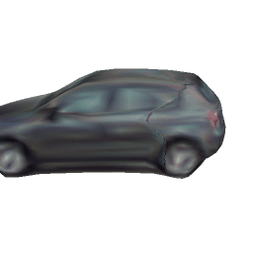
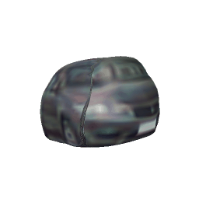
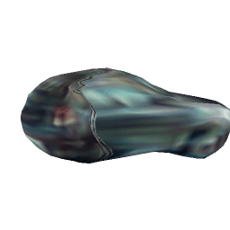
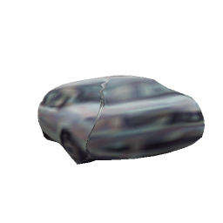
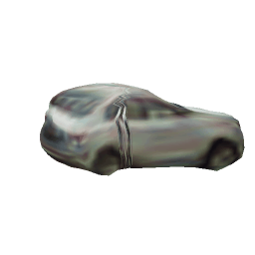
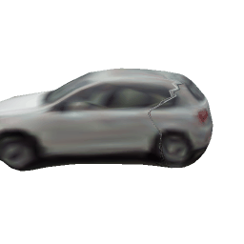
Ablation study
Input
Full model
w/o PC
w/o
Notes:
Let’s analyze the effects of each component by comparing results with our full model
If we remove progressive conditioning, the predicted 3D objects clearly correpsond to degenerate cases
If we remove the neighbor reconstruction loss, the shapes are ok but parts that are not seen from the input views are completely wrong

Slide 7
Results – ShapeNet
Notes:
On ShapeNet, we compared our work with the best supervised methods and obtained comparable performances.
Here are some reconstrutions examples output by our method

Slide 8
Results – real-images
Notes:
We also demonstrate real-image results on various categories like cars
Birds
Motorbikes
And horse

Slide 9
Share With Thy Neighbors: Single-View Reconstruction by Cross-Instance Consistency
Tom Monnier Matthew Fisher Alexei A. Efros Mathieu Aubry
Project webpage
imagine.enpc.fr/~monniert/UNICORN
Code
https://github.com/monniert/unicorn
Notes:
More details are available on our project webpage

